Slide 1


Reflection
Let’s consider what we’ve observed since Dr. Doust first asked us for our help. Recall the questions you submitted to our virtual question board …
What can we now explain?
What do we still need to figure out?
What should out next steps be?
Can we use out knowledge from out experiments to make predictions about another event, or do we need to know more?

Slide 2
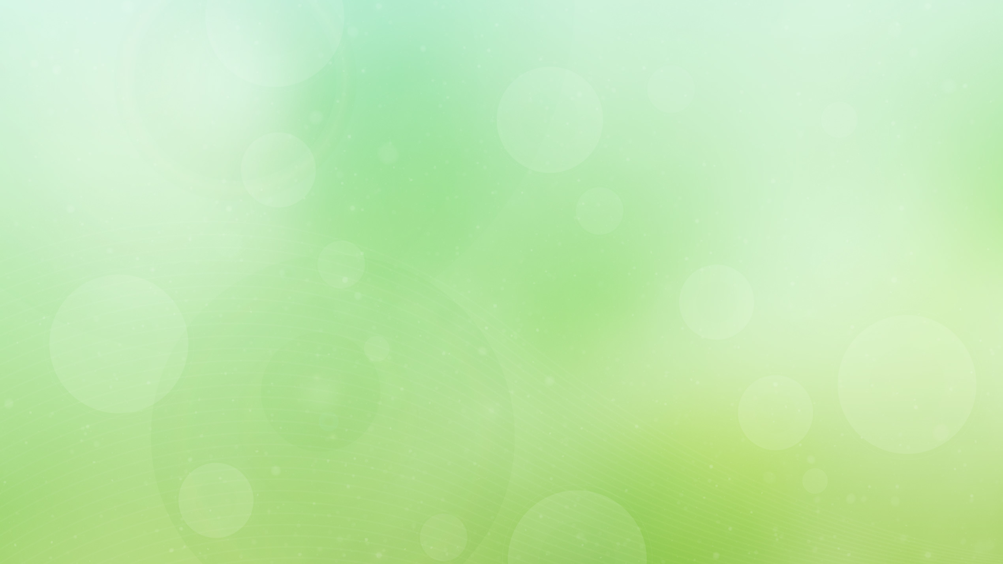
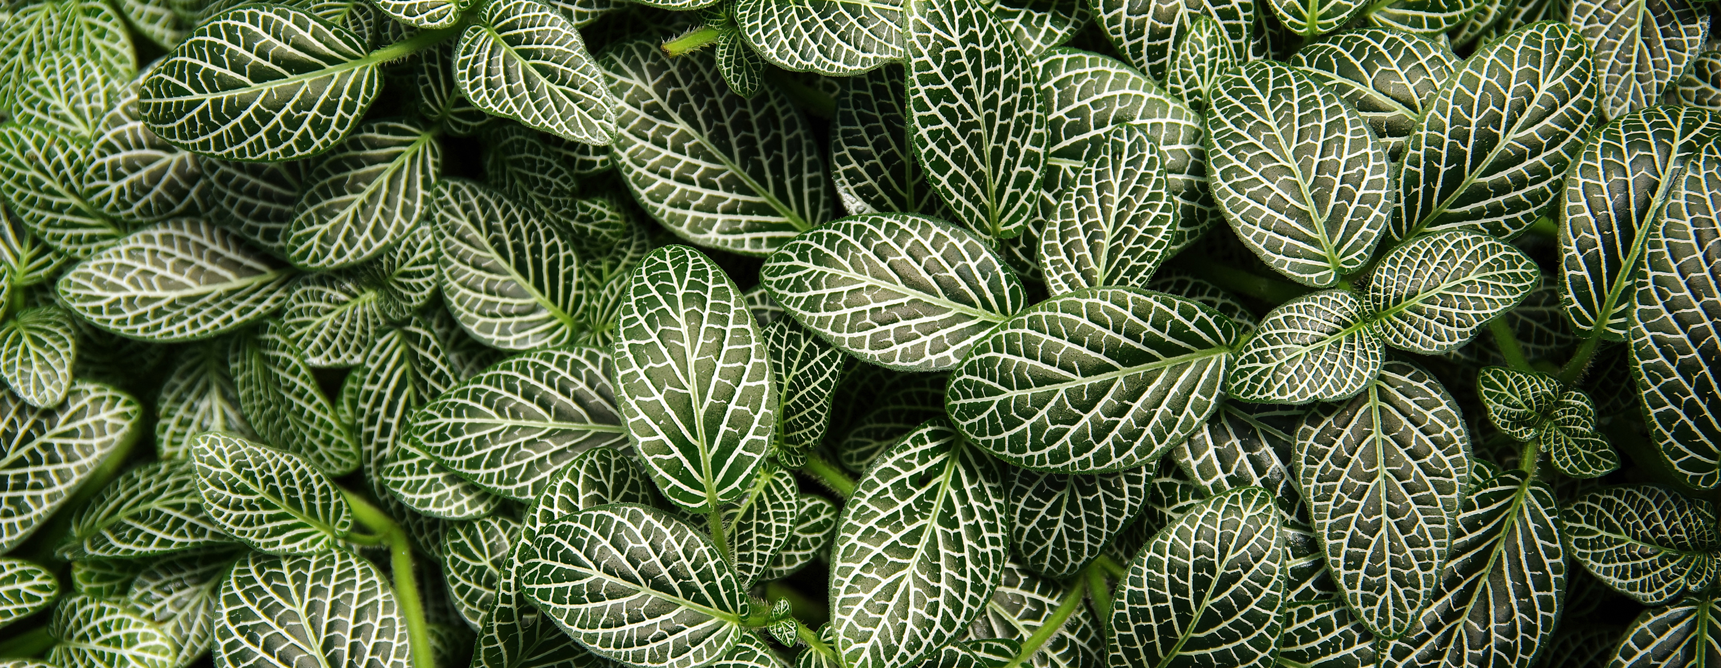
While you were conducting your background research, Dr. Doust and his team ran an experiment of their own …
z

Slide 3
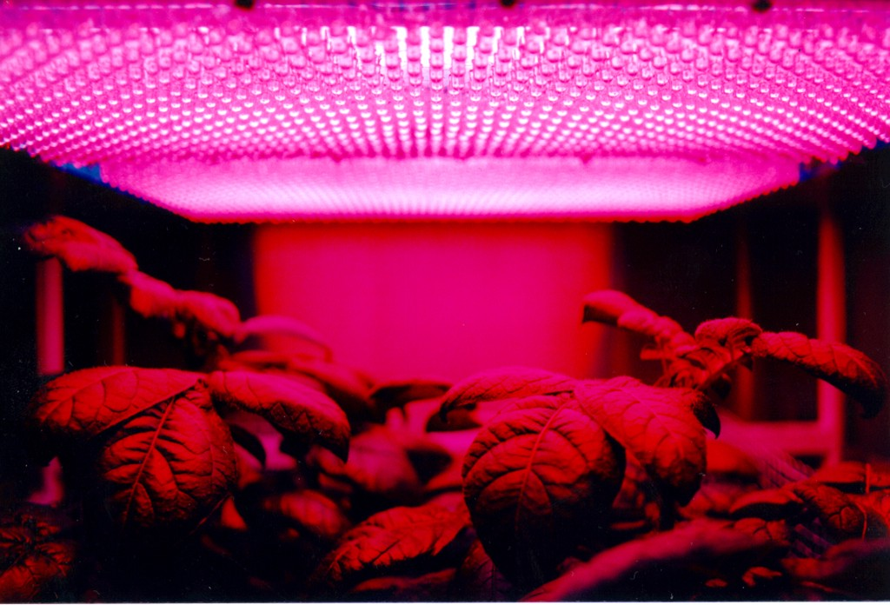
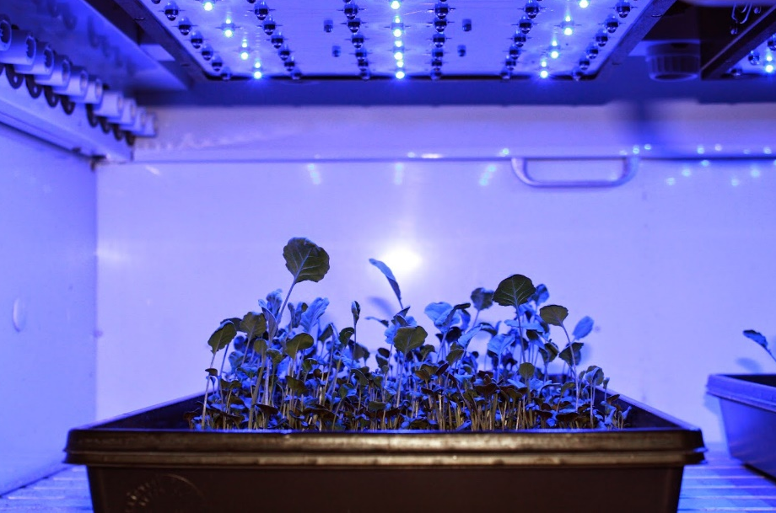
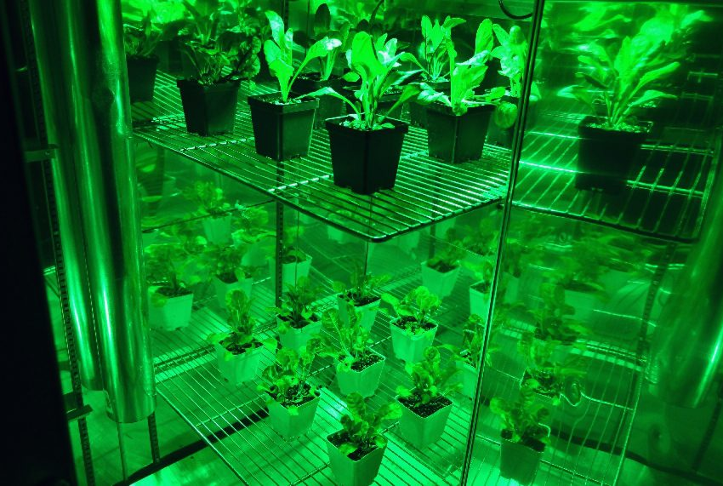
In Dr. Doust’s lab …
They planted five seeds from the mysterious Amazonian plant in three different grow light environments:
  Environment #1 used only red grow lights
  Environment #2 used only blue grow lights
  Environment #3 used only green grow lights
To measure growth, the height of each plant was recorded once a week for eight weeks

Slide 4
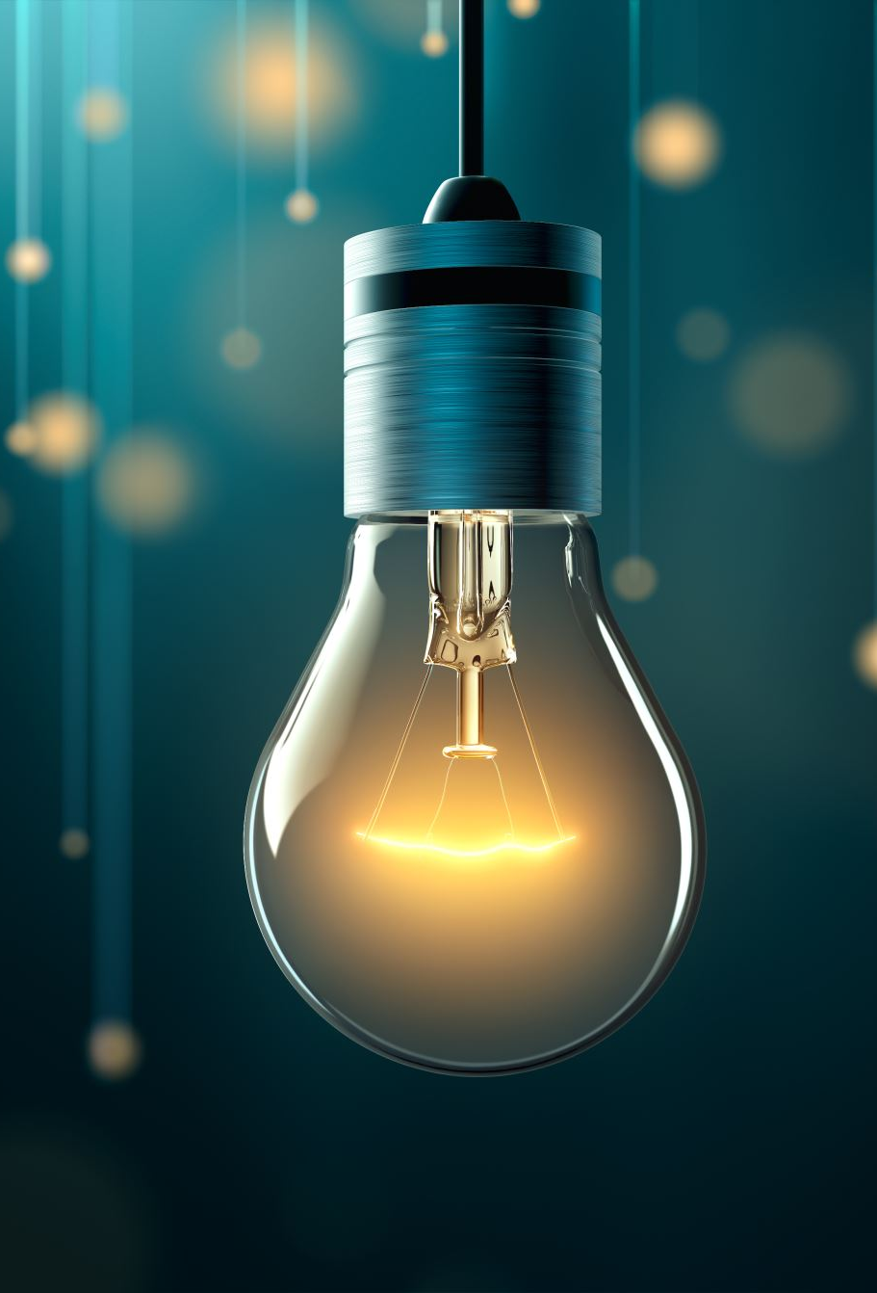
Analysis of the Grow Lights
To better understand the grow lights used, a spectrometer was used to analyze the light within each environment
A spectrometer is an instrument that measures and records the wavelengths composing the light within an environment
  This is known as a spectrum of light

Slide 5
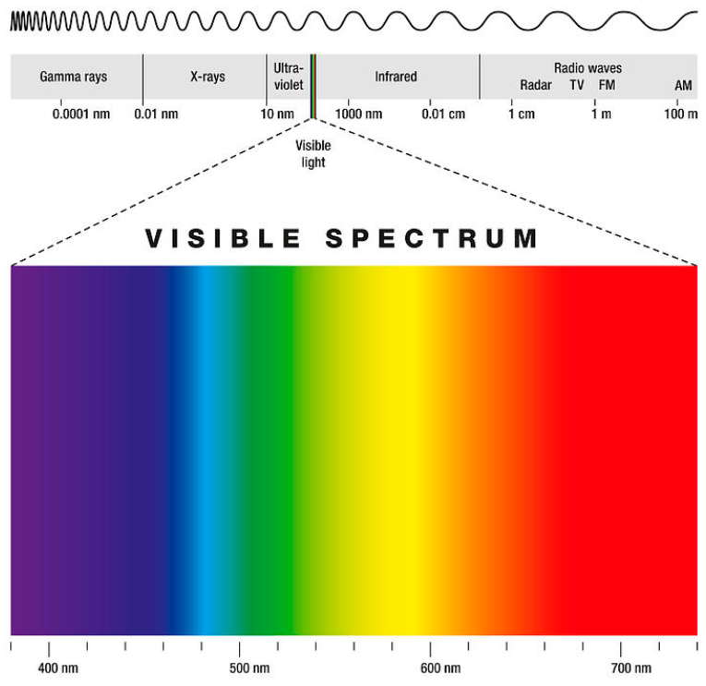
The Visible Spectrum of Light
z
The visible light spectrum is the range of wavelengths that the human eye can see.
Range is subdivided into smaller regions, each corresponding to the different colors we can see.
All objects that we see reflect colors they cannot absorb. White objects reflect all colors, and black objects absorb all colors.

Slide 6
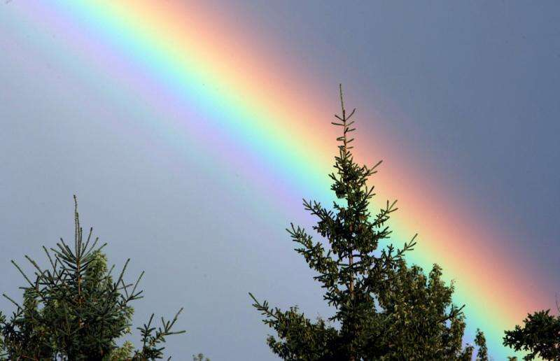
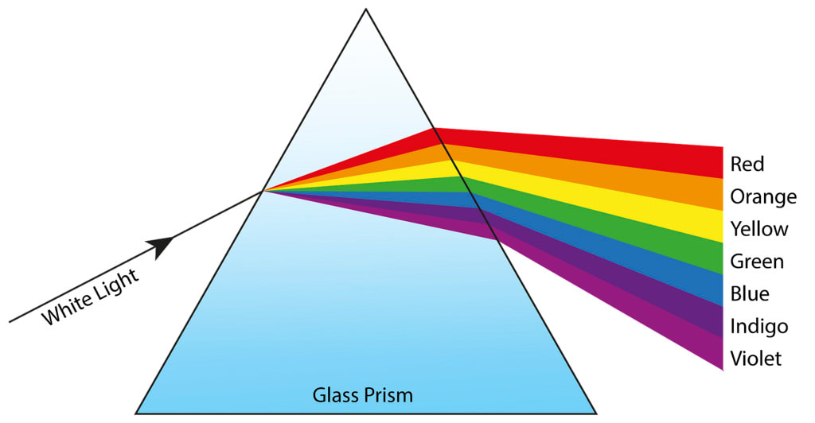
The Rainbow Effect
z
The colors we see consist of different wavelengths on the visible spectrum of light
When these wavelengths pass through transparent mediums, such as a raindrop of a window frame, the light is bent. This is known as refracting.
Light waves with shorter wavelengths bend the most, while light waves with longer wavelengths bend the least.
This is what causes the arch of colors that we see in a rainbow!

Slide 7
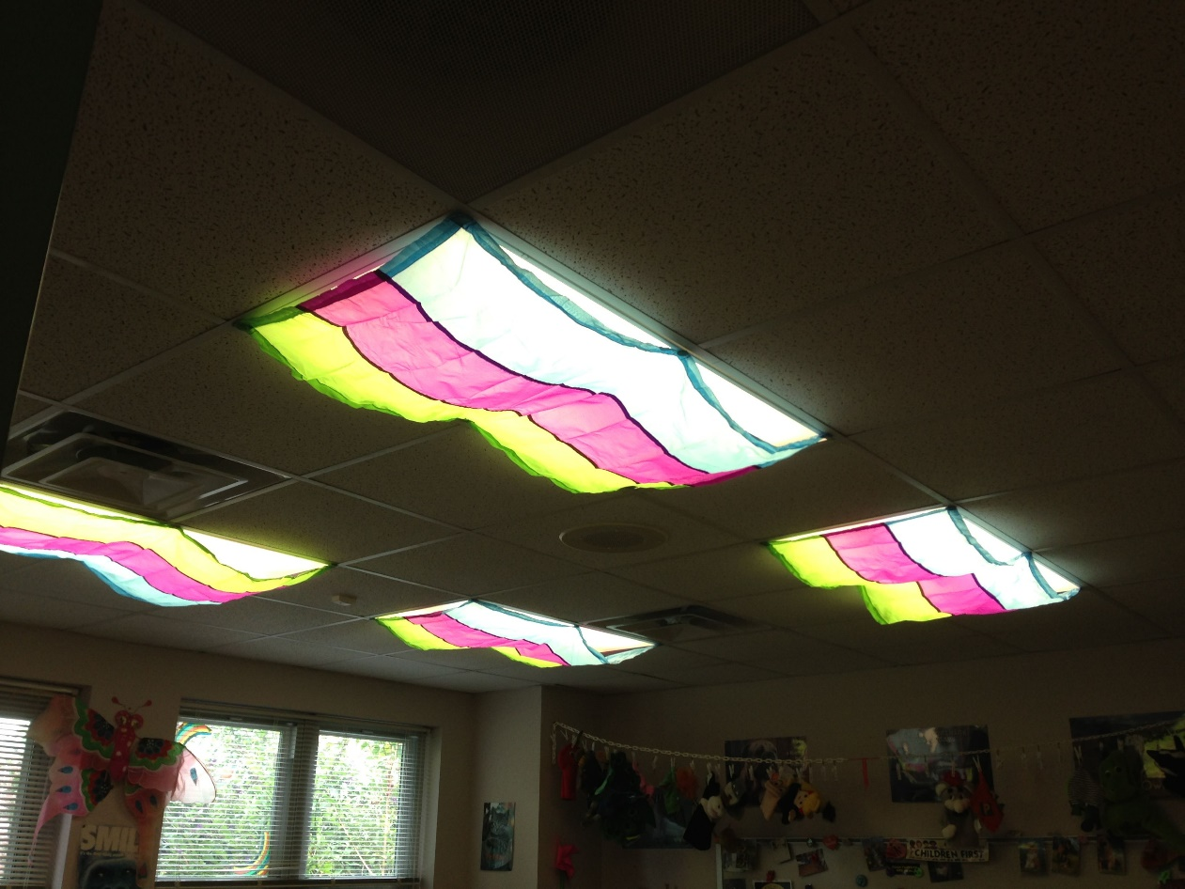
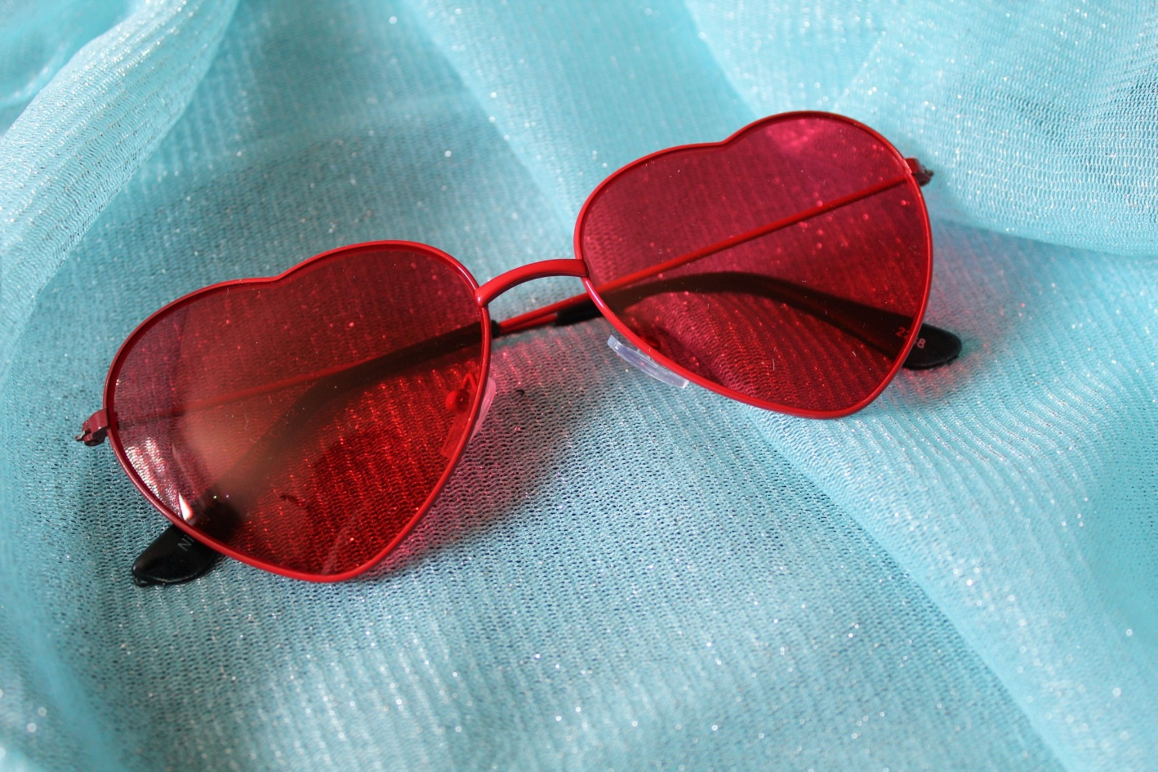
Filtering Light
z
When wavelengths of light encounter other types of mediums, they are sometimes unable to pass through
This is called the filtering of light, where only certain colors of light pass through a medium
This can happen when light passes through colored tissue paper, sunglasses, etc.

Slide 8
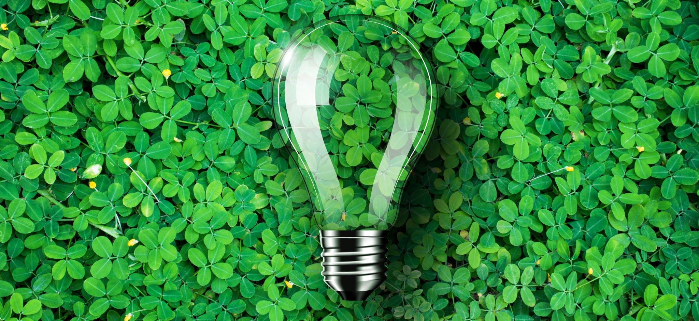
How will different concentrations of wavelengths impact plant growth?
This visible spectrum of light is the same light plants use during photosynthesis …

