Slide 1

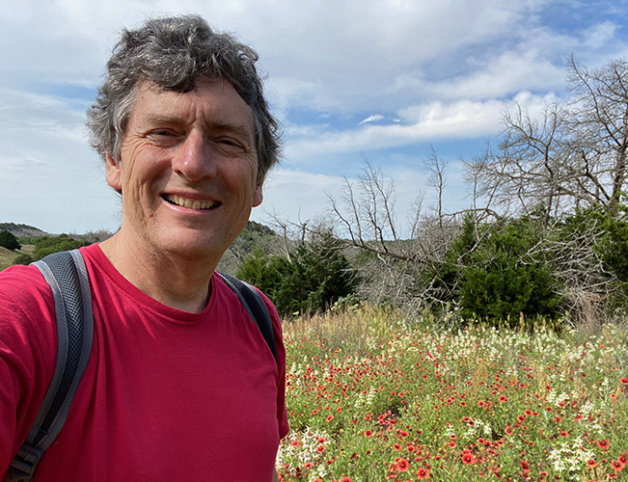

You’ve got mail!
We just received a letter, addressed to our class.
The letter is from Dr. Doust, an intrepid international plant collector and plant biologist from Australia.
Let’s see what he has to say!

Slide 2
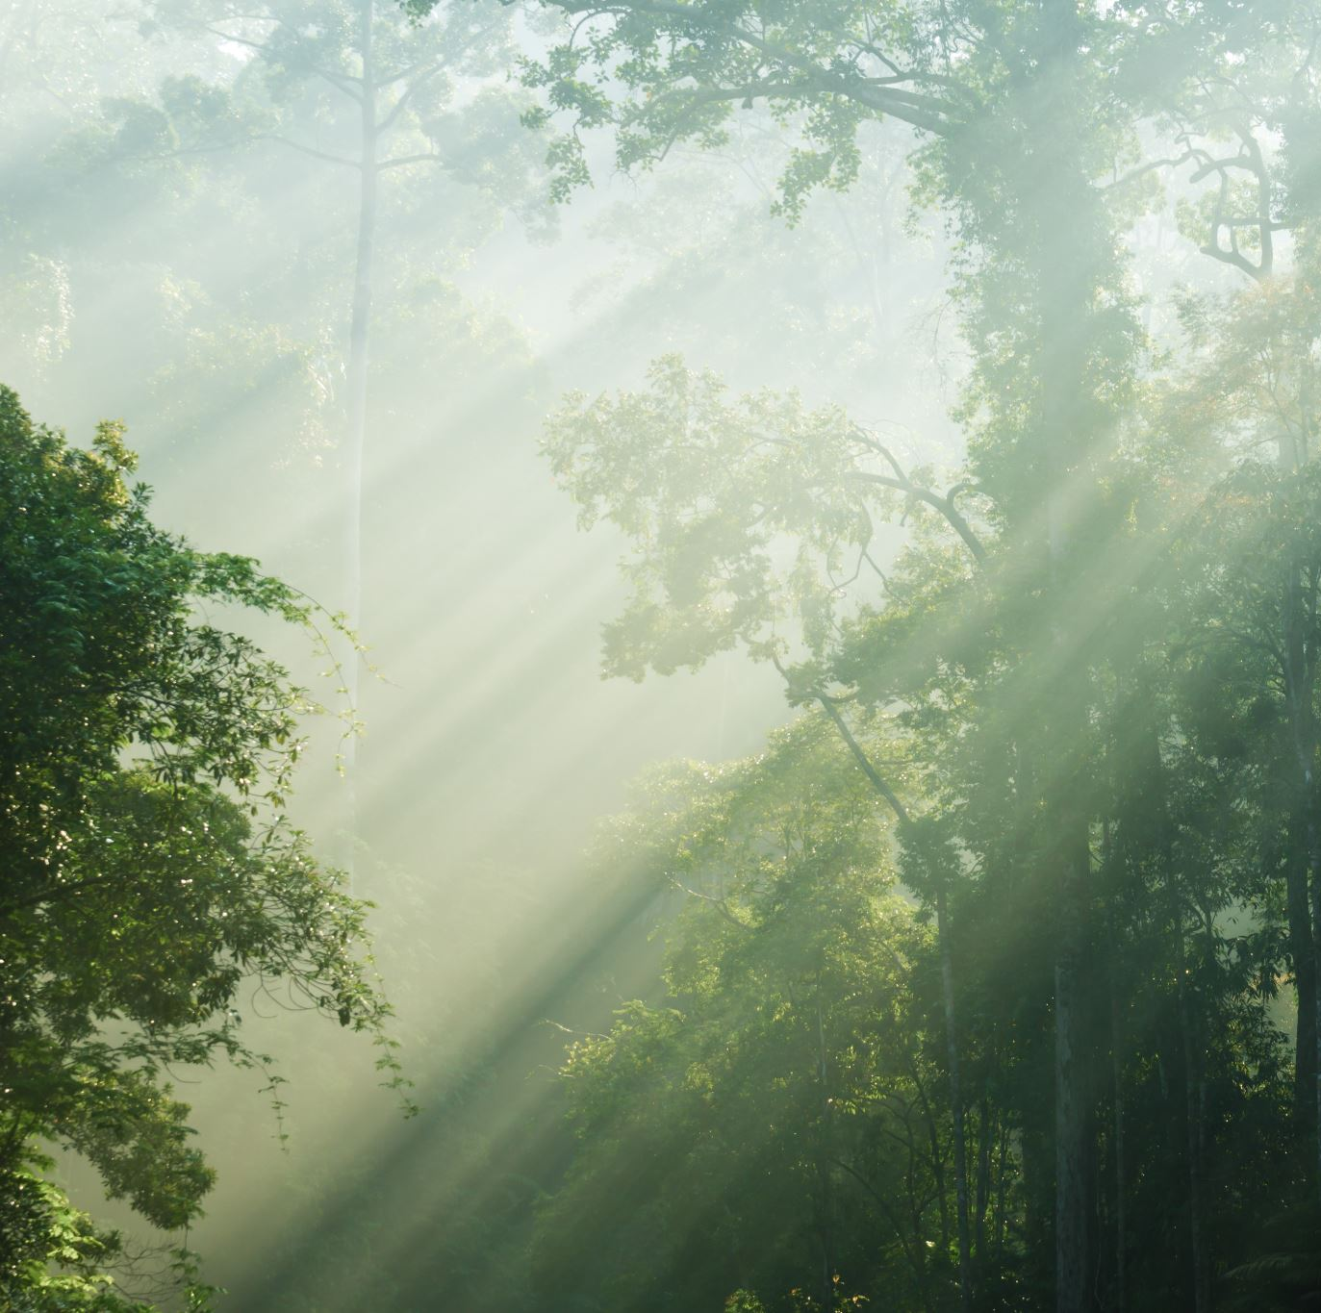
In the letter …
Dr. Doust explains that he and his lab team recently embarked on an expedition to the Amazon rainforest.
While trekking through the foliage, they encountered a mysterious, bright blue-green plant.
Dr. Doust decided to collect some seeds from this plant before he and his team returned to their laboratory in Australia.

Slide 3


Dr. Doust needs your help!
He wants to determine how he can mimic the mysterious plant’s home environment in his lab.
But … What would this plant need to succeed in his lab? What factors may influence the plant’s growth?

Slide 4
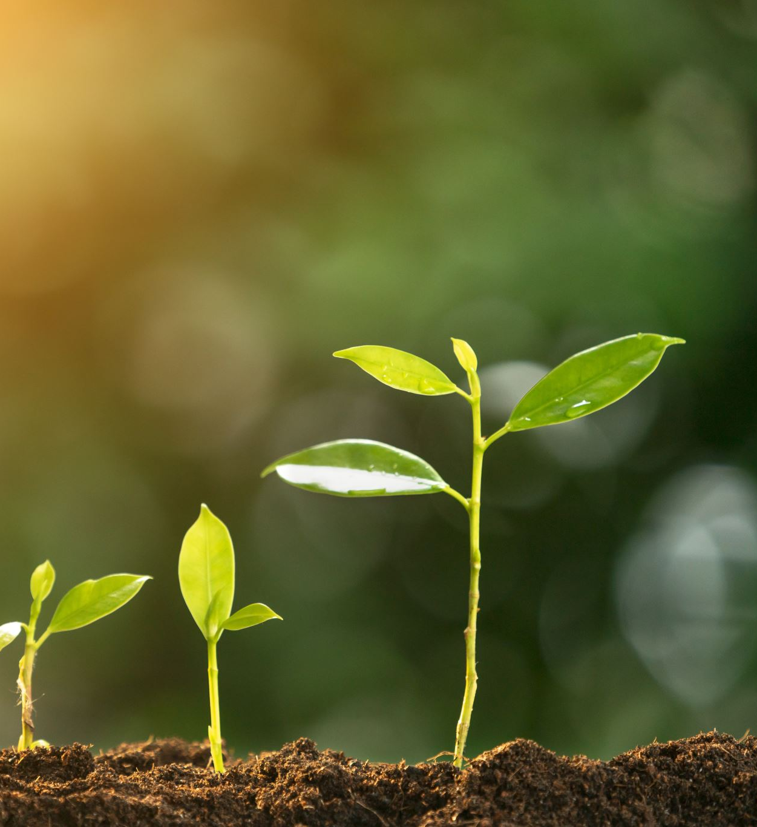
Environmental Influences on Plant Growth
To observe how different factors could influence plant growth, Dr. Doust planted various radish plants in different environments inside his lab and in his outdoor garden.
The next five slides will display images of Dr. Doust’s radish plants growing in a variety of lighting conditions.

Slide 5
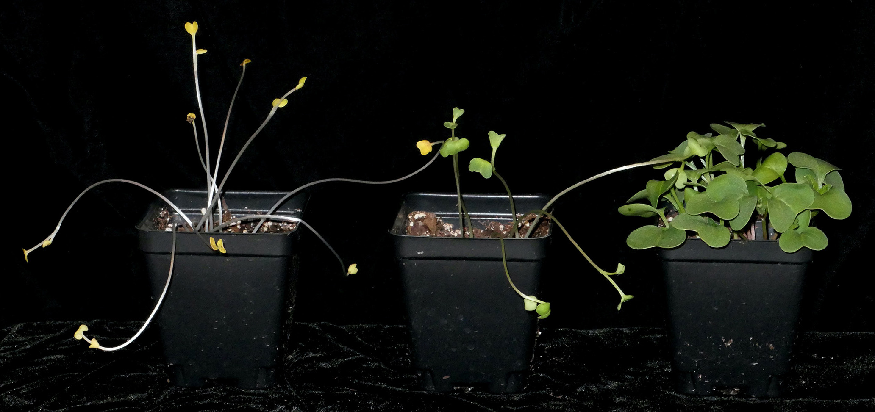

Image #1
The leftmost radish plant was germinated in the dark, the middle radish plant was germinated in dim light, and the rightmost radish plant was germinated in bright light.

Slide 6
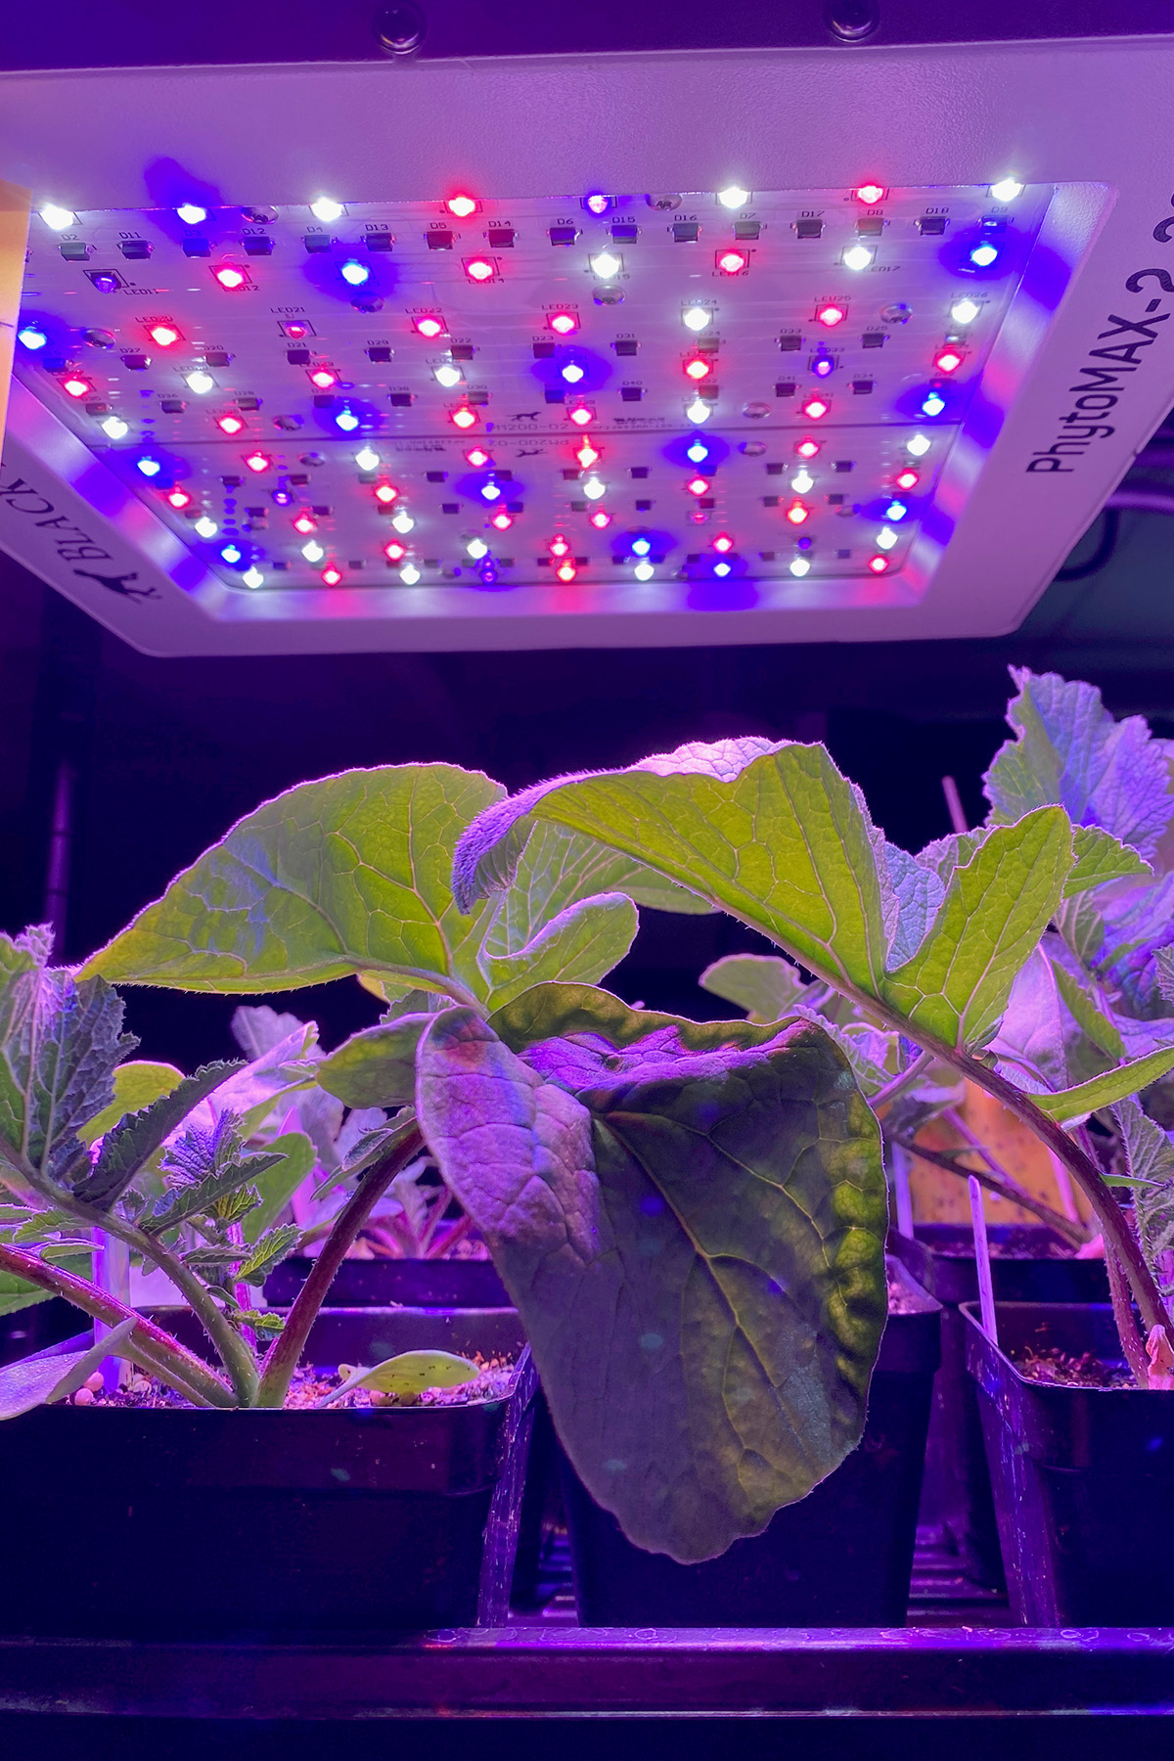
Image #2
Radishes grown under red and blue LED lights.

Slide 7
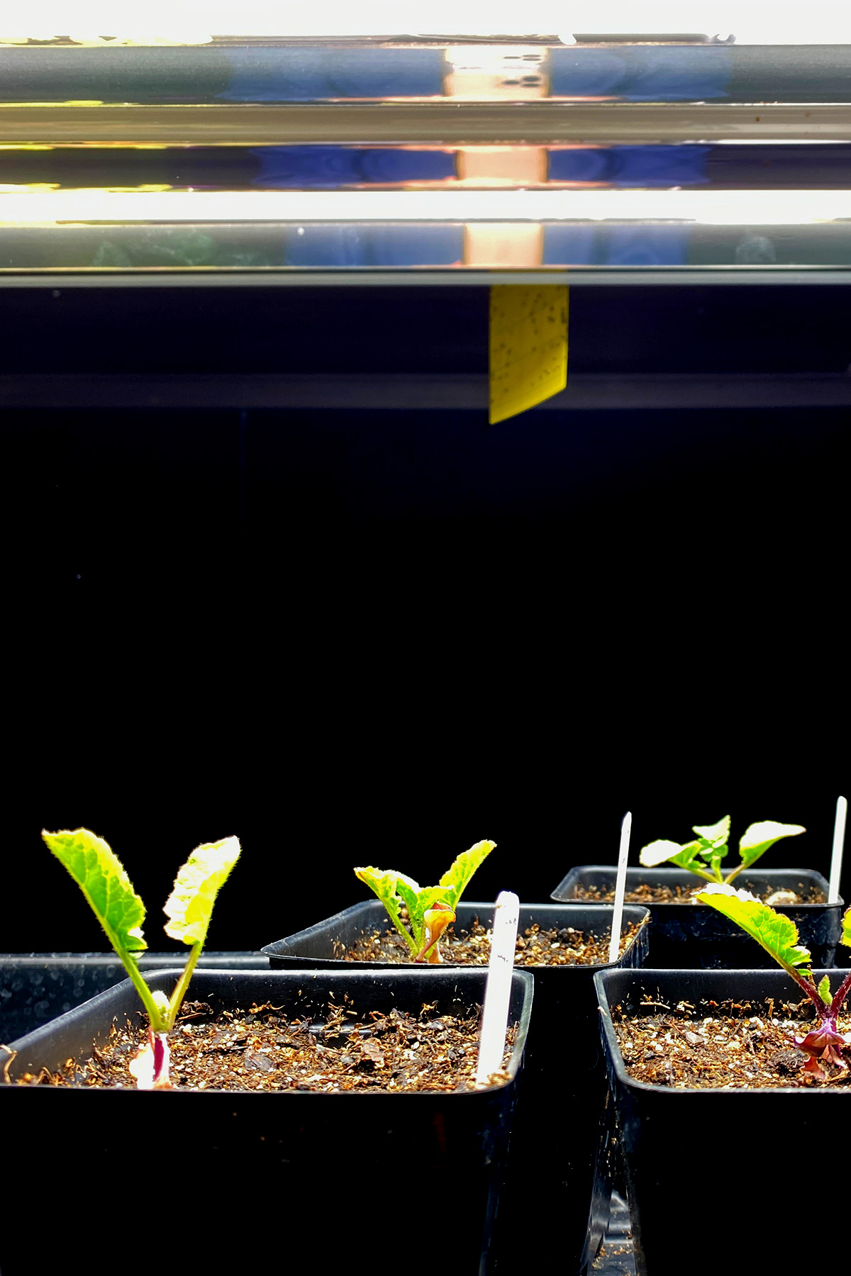
Image #3
Radishes grown under white fluorescent lights.

Slide 8
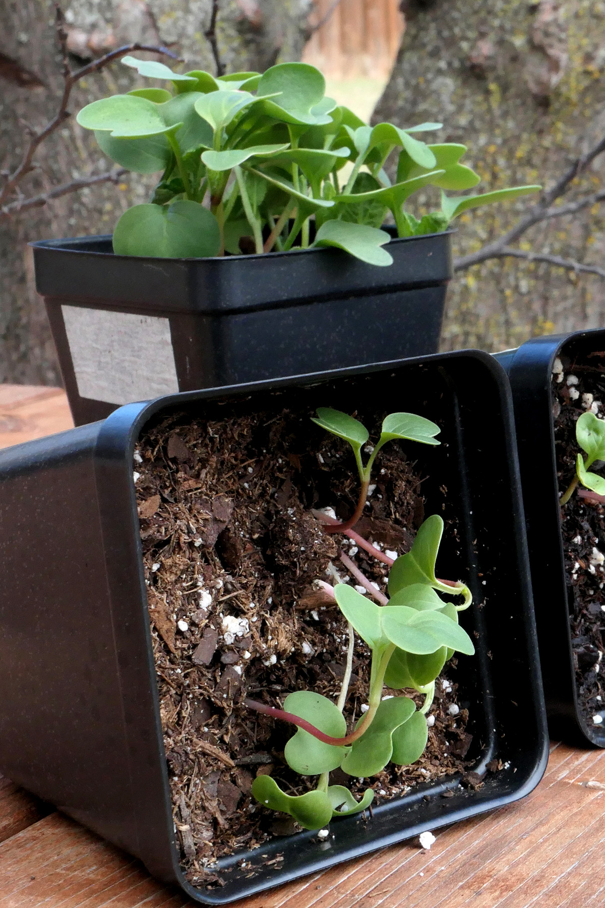
Image #4
Radish grown outdoors, turned sideways during growth.

Slide 9
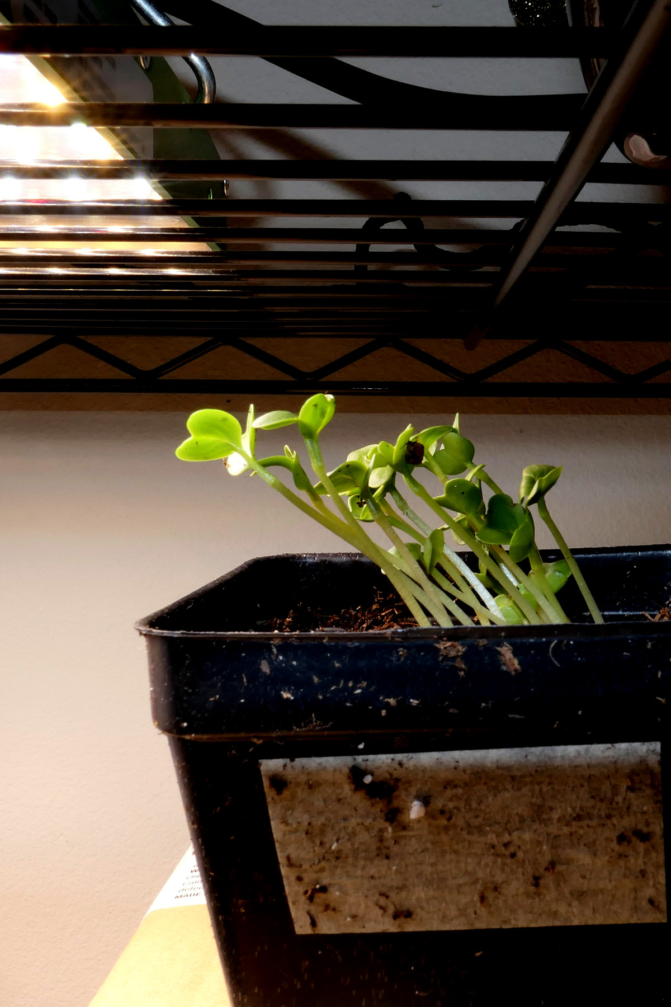
Image #5
Radish seedlings growing indoors, with a light source to the side of the plant.

Slide 10


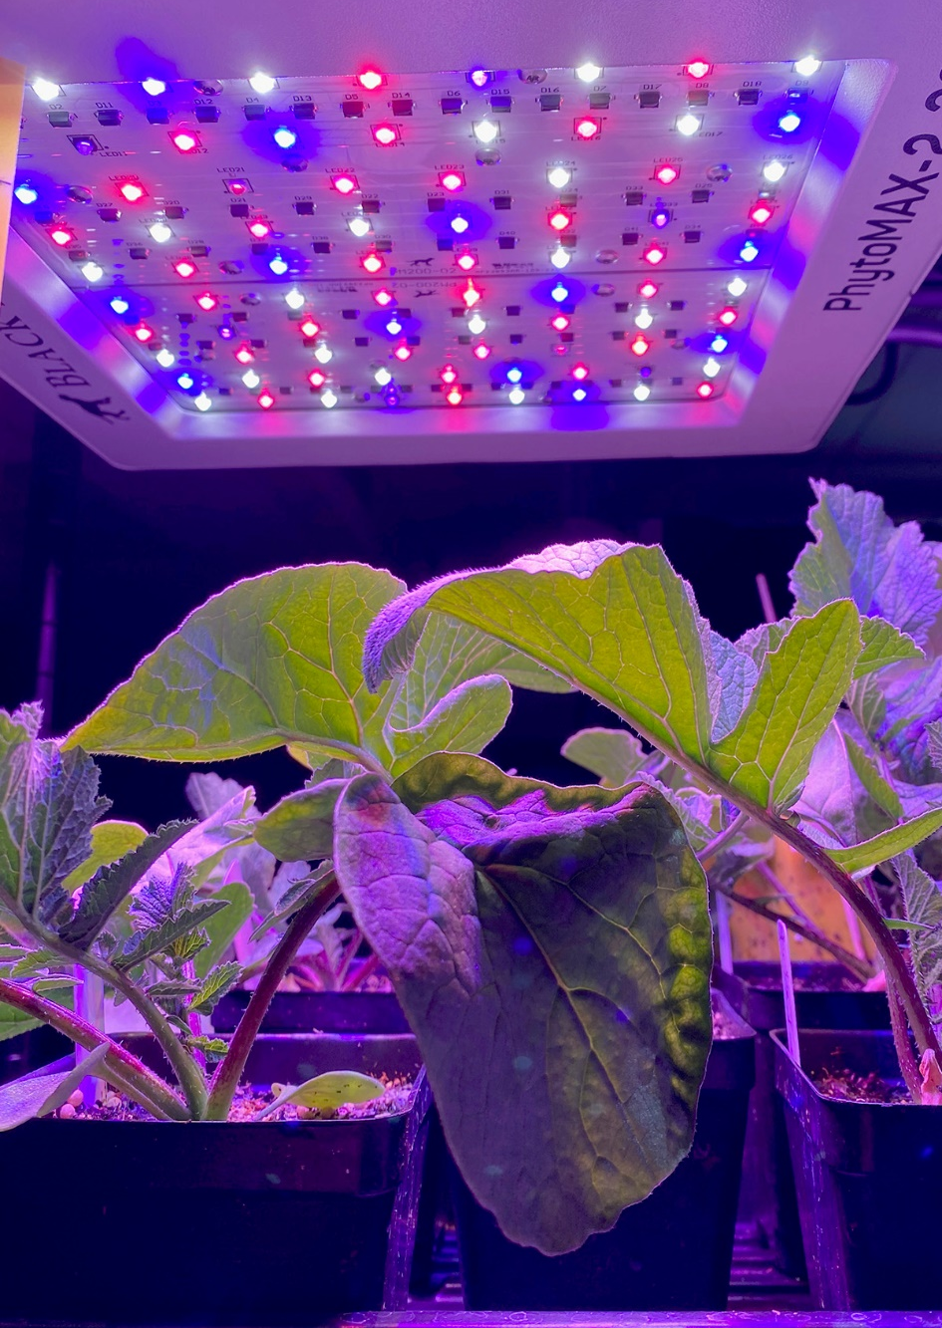
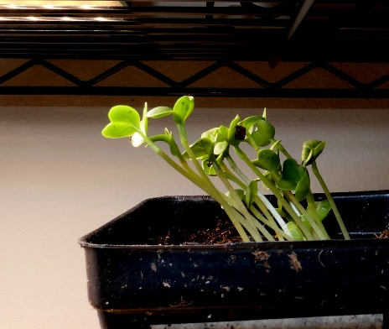
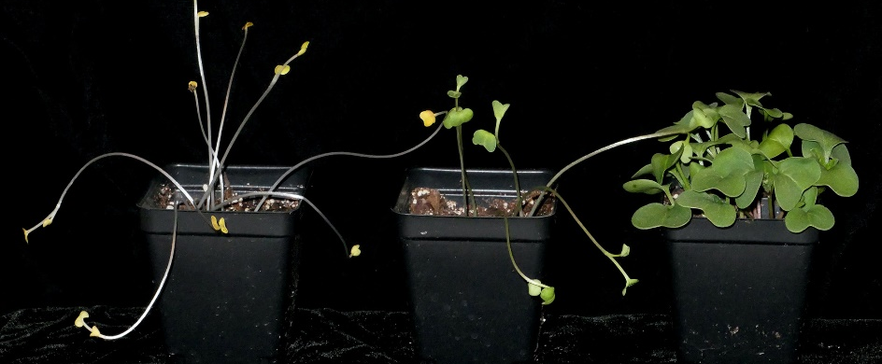
How would you describe the radish plant’s growth in each of these images?
How do the radish plant’s growth compare with one another? How are they similar? How are they different? In what way?
What do you think would happen if we planted the mysterious seeds under the various lighting conditions that Dr. Doust prepared for these radish plants?
  Would they grow similarly as the radishes did? Would they grow differently?
What would a plant need to be successful in ANY environment?

Slide 11
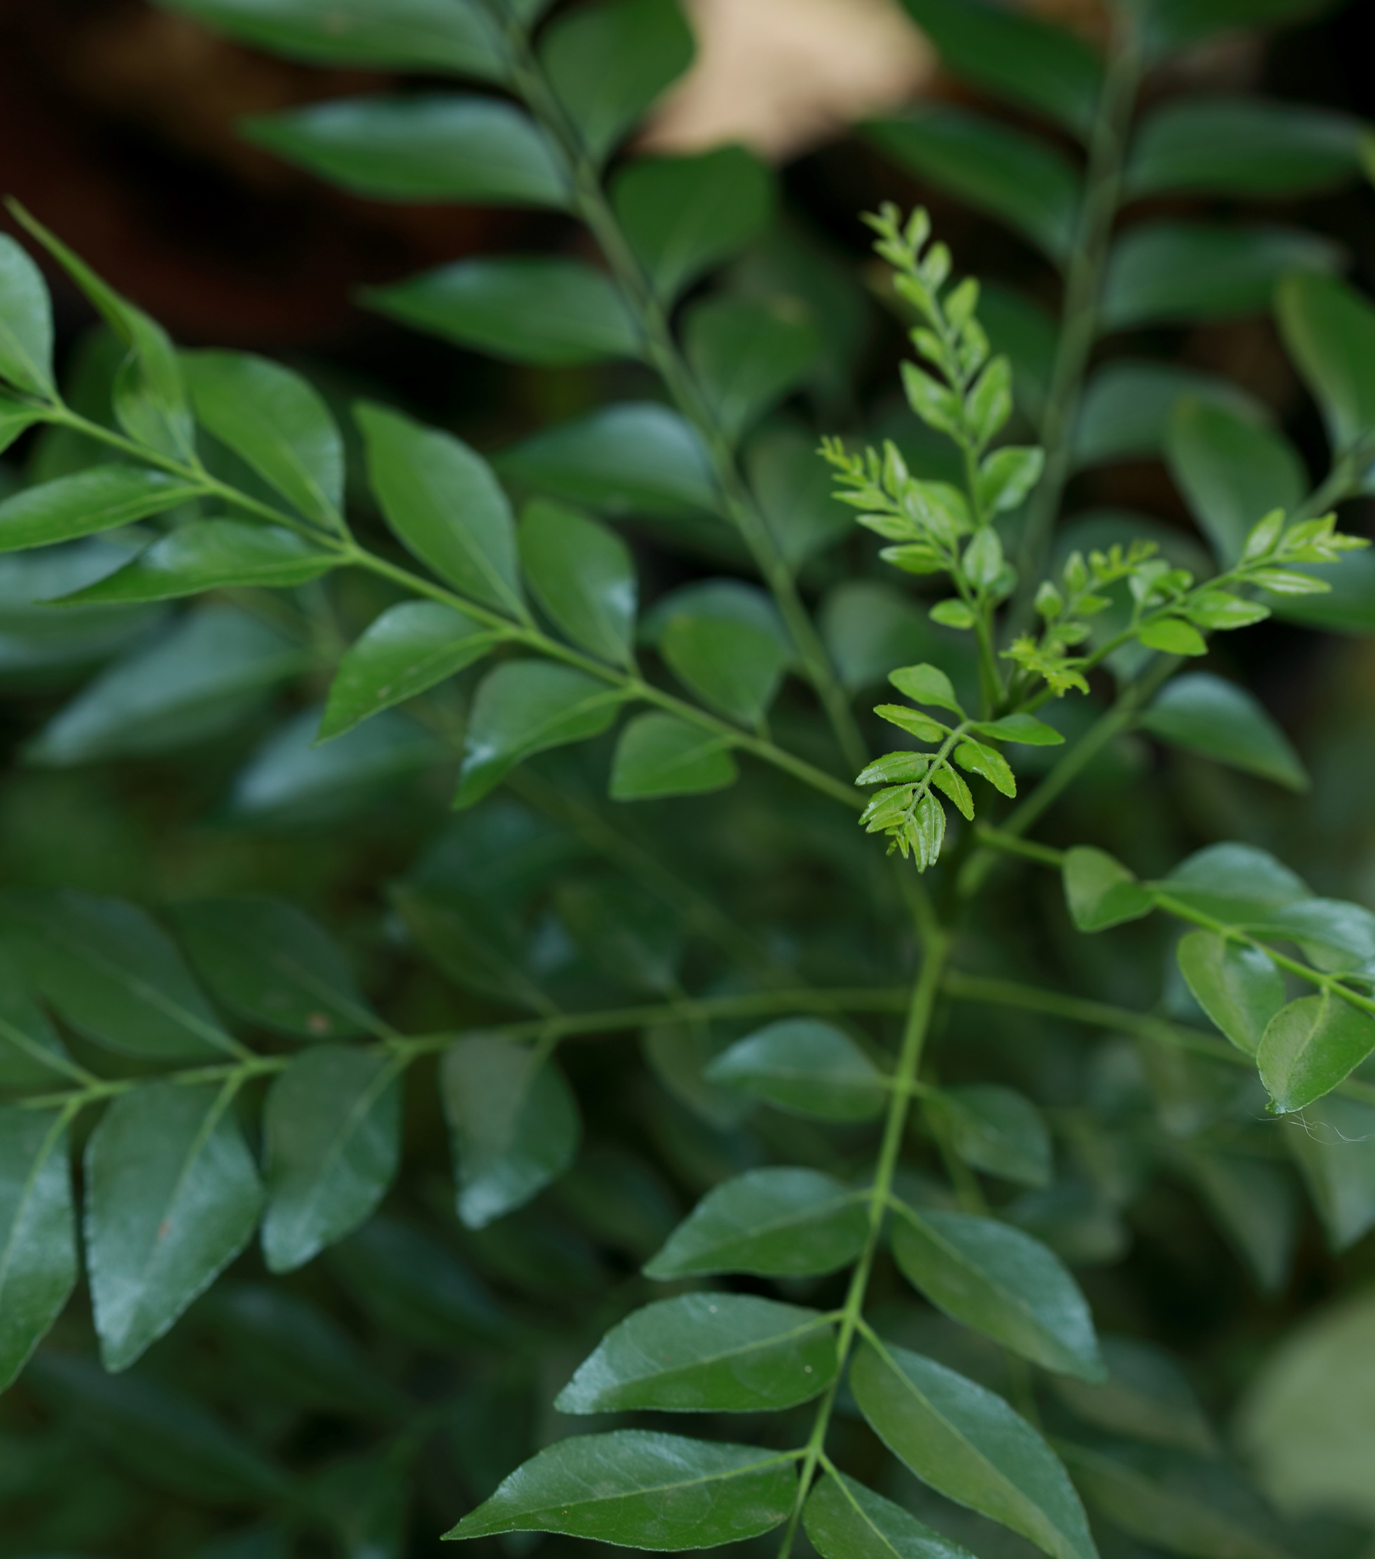
Dr. Doust explains in his letter …
Botanists know a lot about how the amount of light and the direction of light may affect a plant’s growth.
However, scientists understand relatively little about the role of the color of light.
The color of light in the rainforest is affected by all of the plants growing there, but he is not sure how to replicate the color conditions in his lab to BEST support the mysterious Amazonian plant.

Slide 12
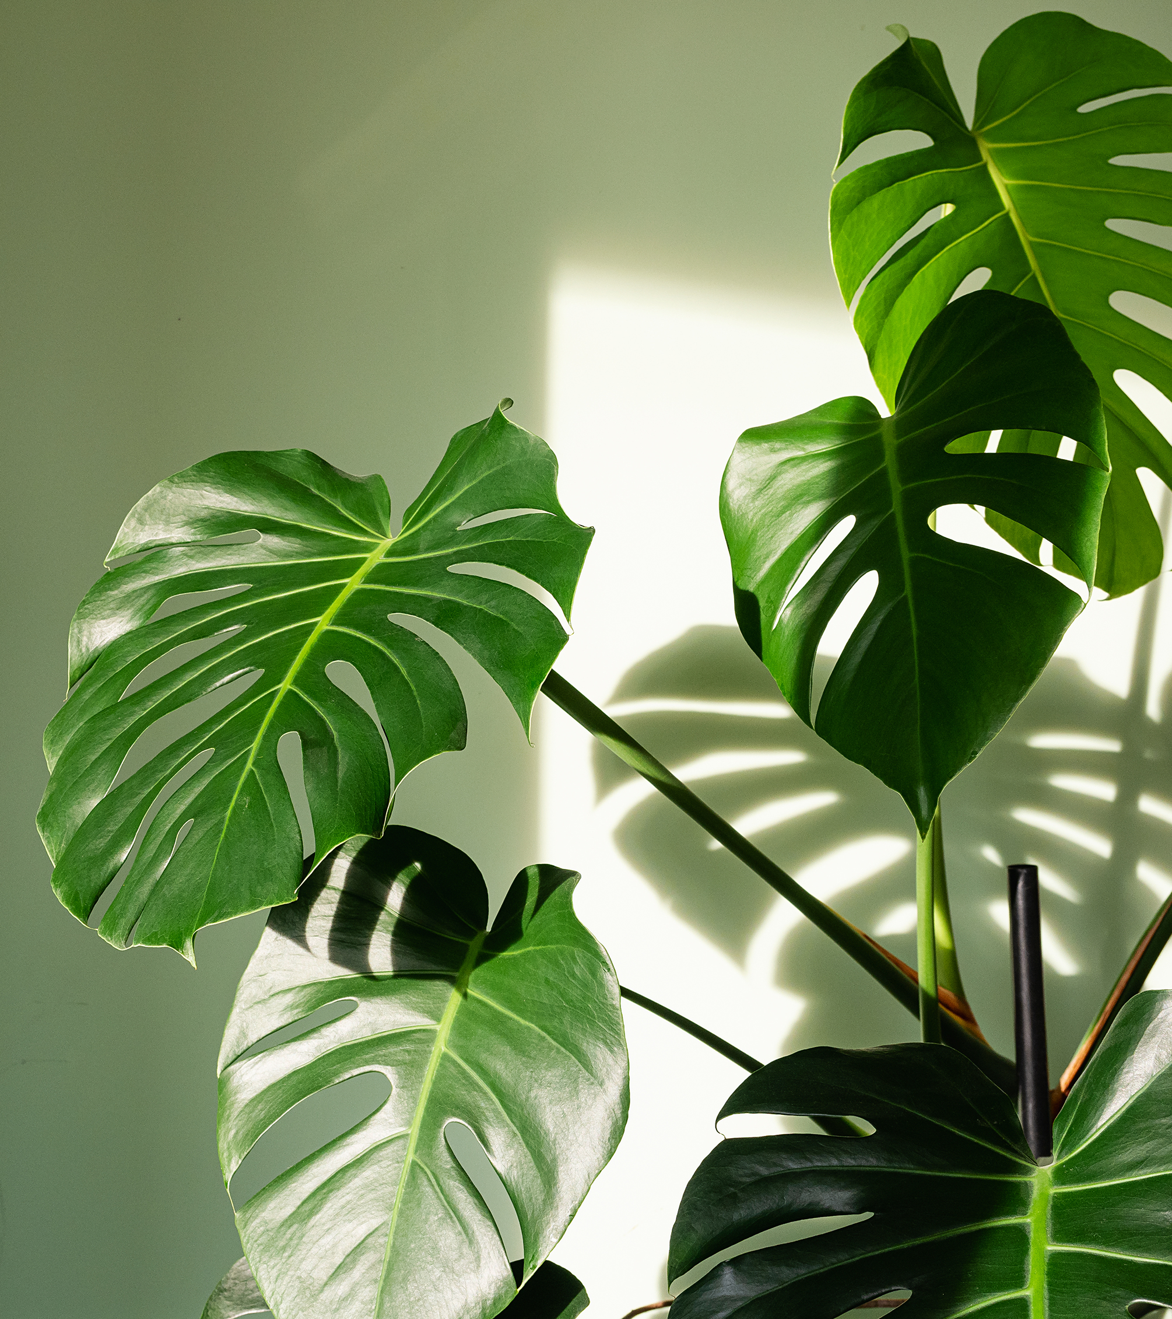
Dr. Doust asks …
What do I need to know that will help me identify an environment with the BEST growing conditions for our mystery plant?
In groups, generate a question relating plant growth and the environmental conditions a plant needs to grow.
Elect a spokesperson in your group. They will submit your group’s question to our virtual question board!
Record your question and the name of your spokesperson on the provided handout.

Slide 13

Padlet link:
*insert link to Doust Lab Padlet here*
*insert QR Code to Doust Lab Padlet here*

