Slide 1
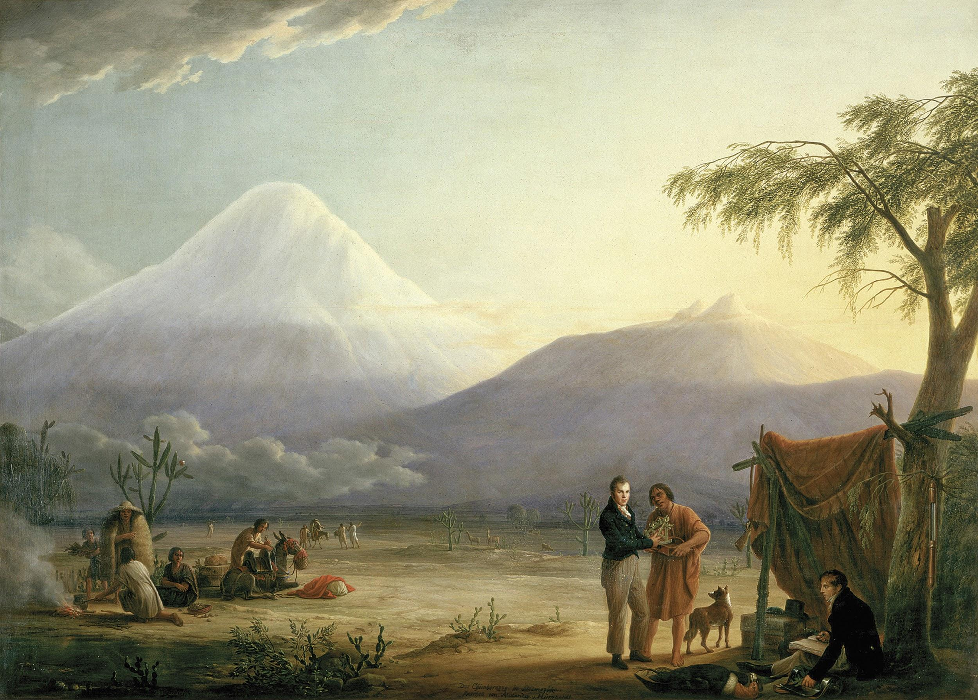
Alexander von Humboldt

Slide 2
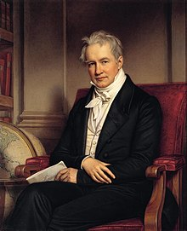
Alexander von Who???
“Alexander von Humboldt has been largely forgotten in the English-speaking world.” (Andrea Wulf)
Humboldt (1769 - 1859) was a Prussian (German) geographer, naturalist, and explorer. At one point, he was the most famous man in the world, rivaled only by Napoleon.

Slide 3
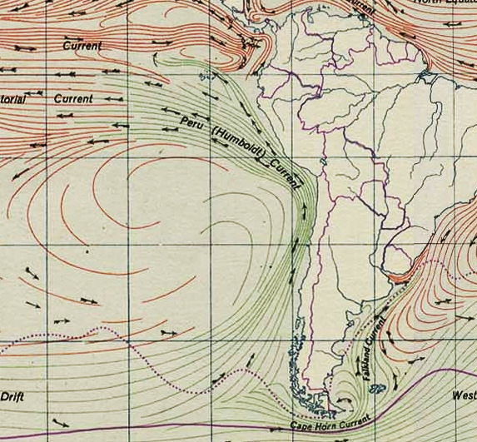

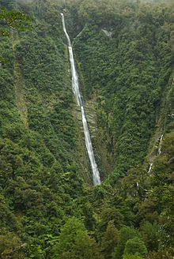
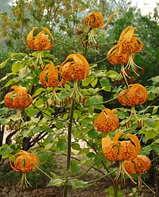
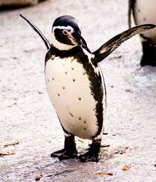
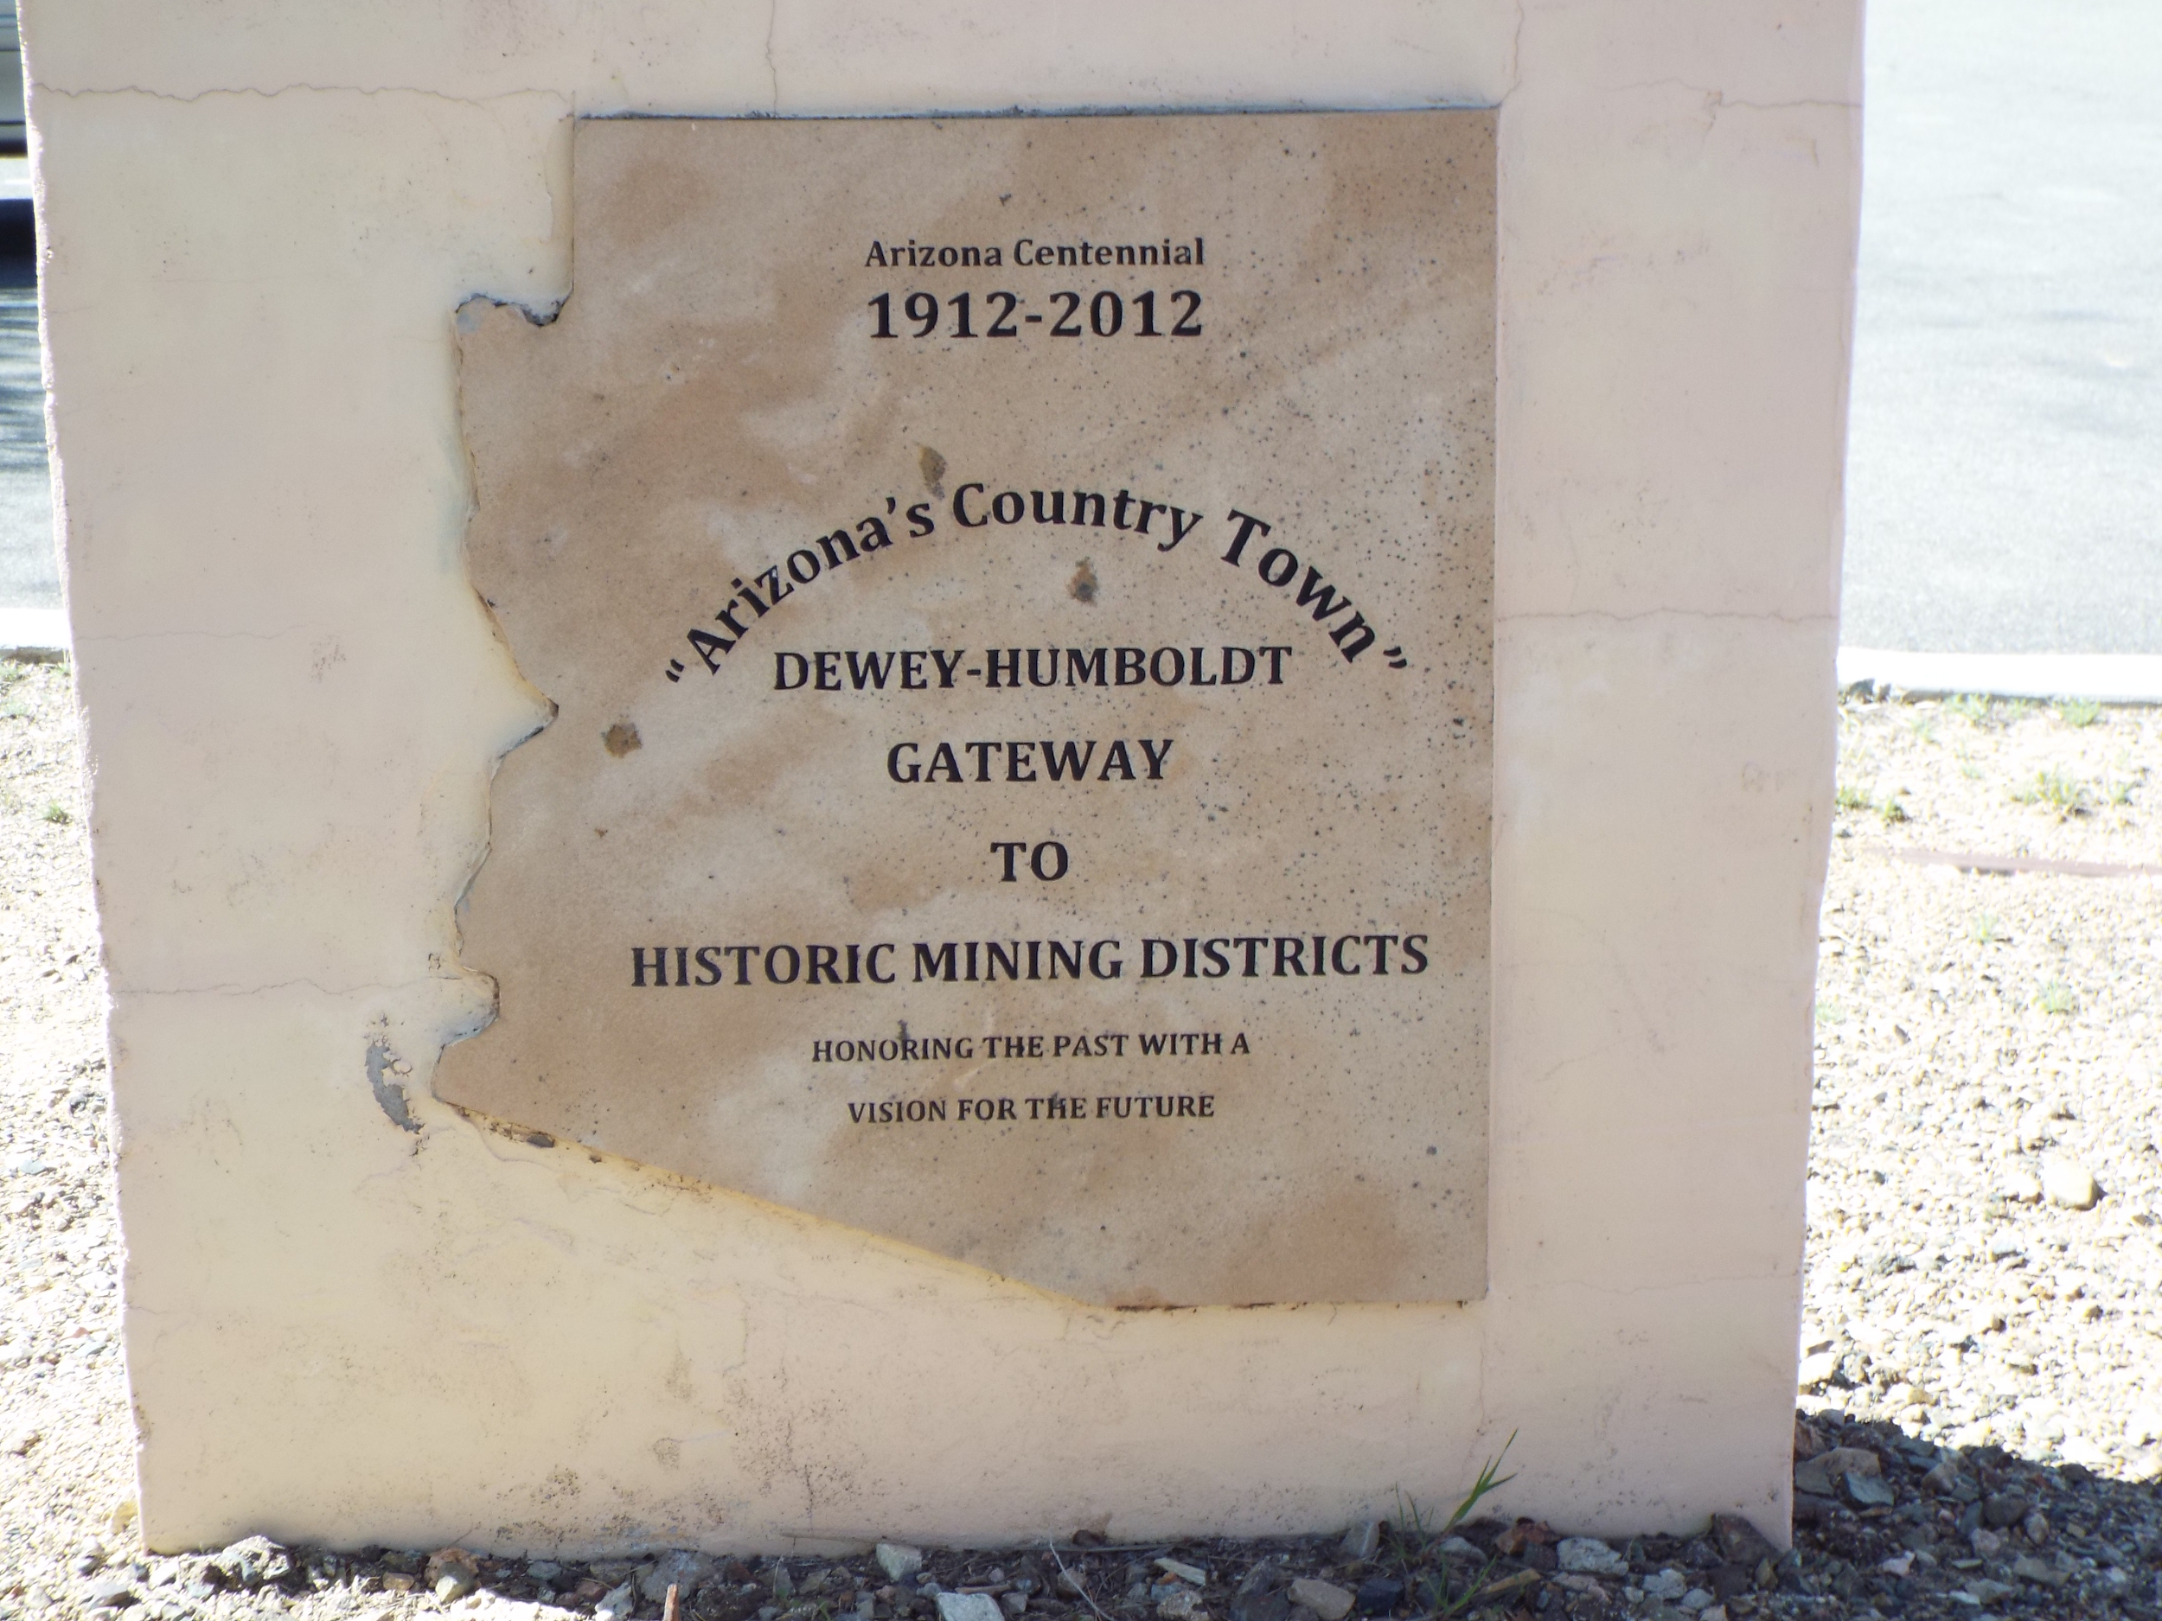
A very important man indeed
More plant and animal species are named after Humboldt than any other human being.
Geographic features, universities, and places are also named after Humboldt.

Slide 4
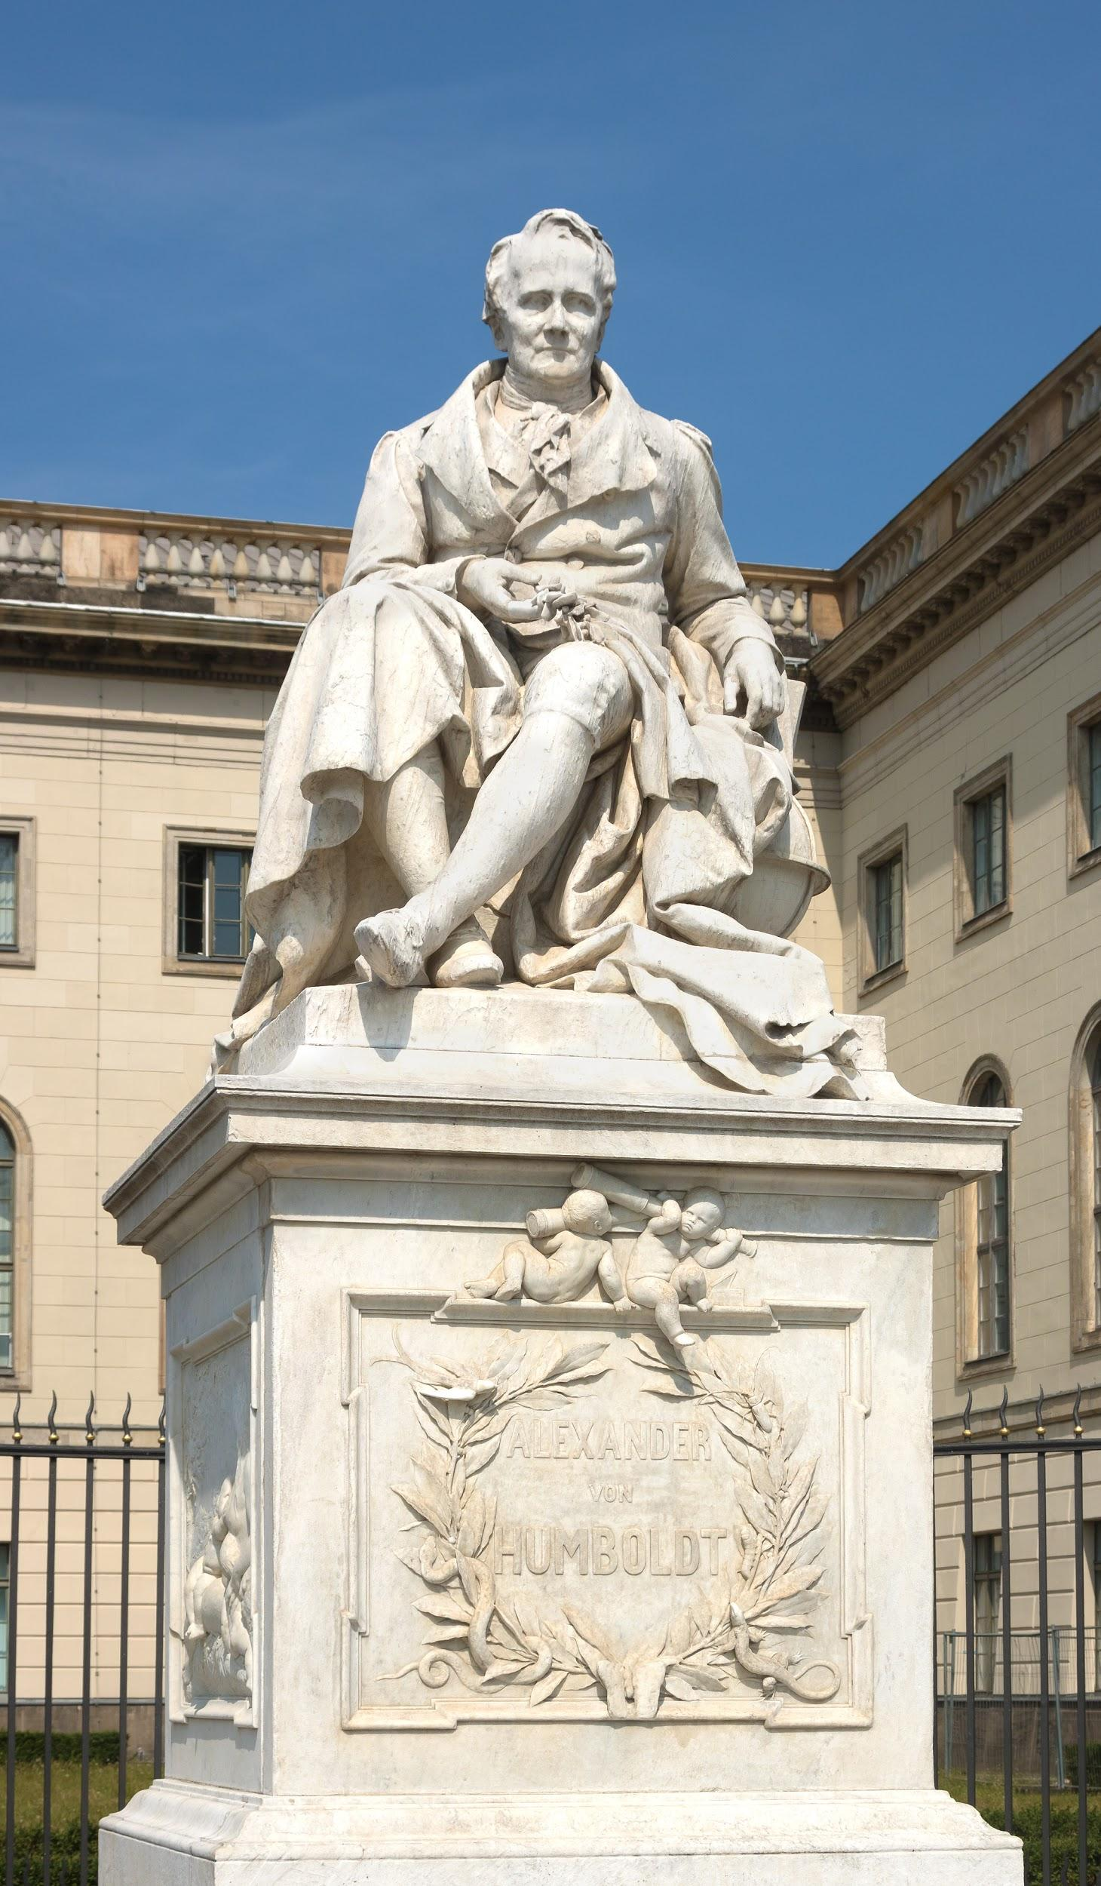
Field of biogeography
Placed a high emphasis on observation and collection of plant specimens.
Combined biology, meteorology, and geology to determine where specific plants grow.
Others base their work off of Humboldt and his colleagues’ findings.

Slide 5
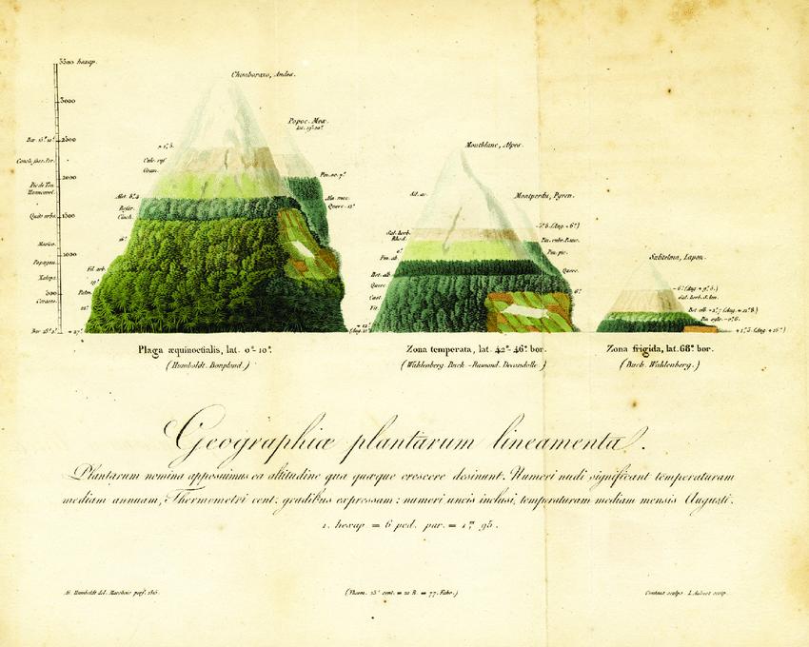
Botanical Geography
Left - tropical mountains (Chimborazo, Ecuador)
Middle - temperate mountains (Mont Blanc, Alps)
Right - subarctic mountains (Sultielma, Lapland)

Slide 6
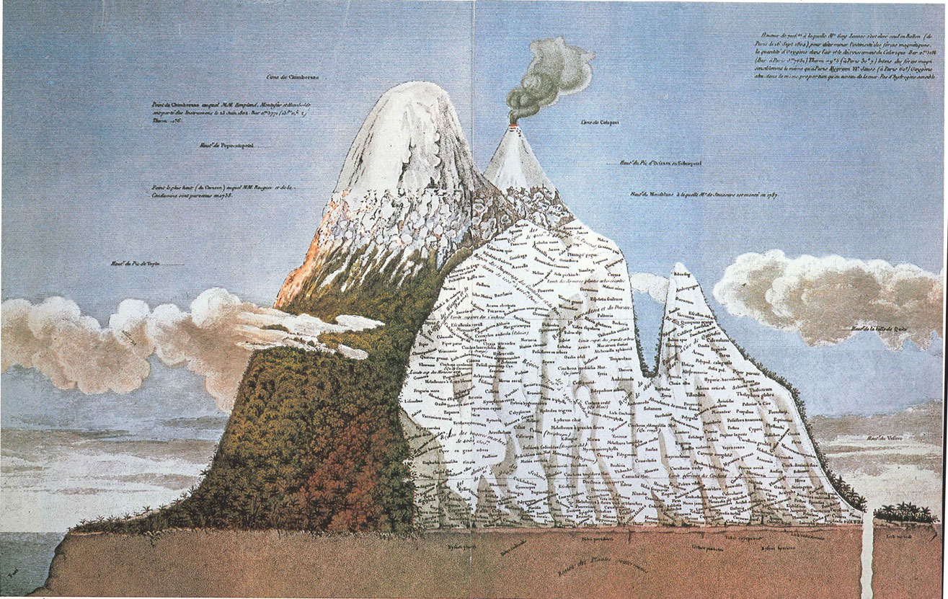
Essay on the Geography of Plants
Chimborazo Volcano, Ecuador
Documented the temperature, altitude, humidity, atmospheric pressure, and the plants/animal found at each elevation.
Concluded that environmental factors affect the distribution of life forms.

Slide 7
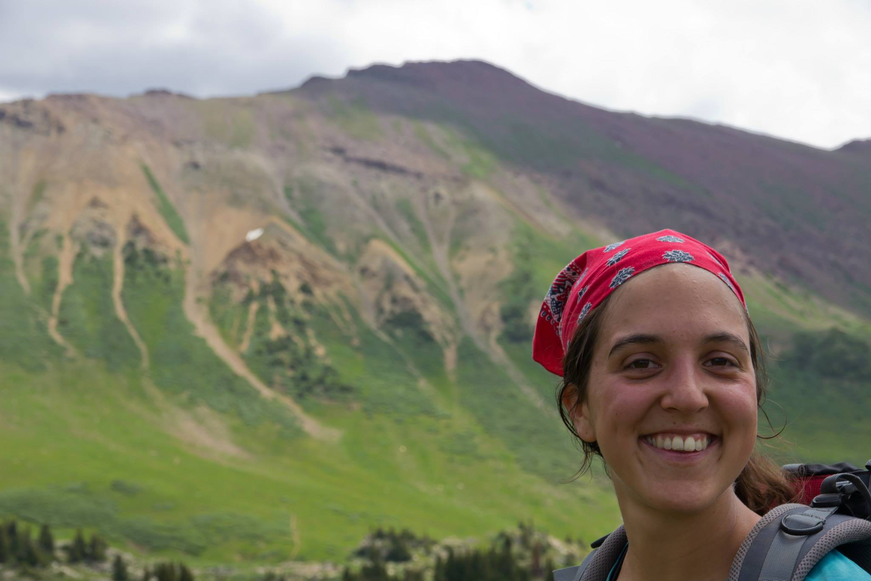
Naia Moruea-Holme, PhD
Macroecologist at the University of Copenhagen
She is “interested in what drives the diversity and distribution of species, and how environmental changes have and will impact the natural world.”
Her current research program focuses quantifying the impact of humans on the distribution of life on Earth from local to global scales.

Slide 8
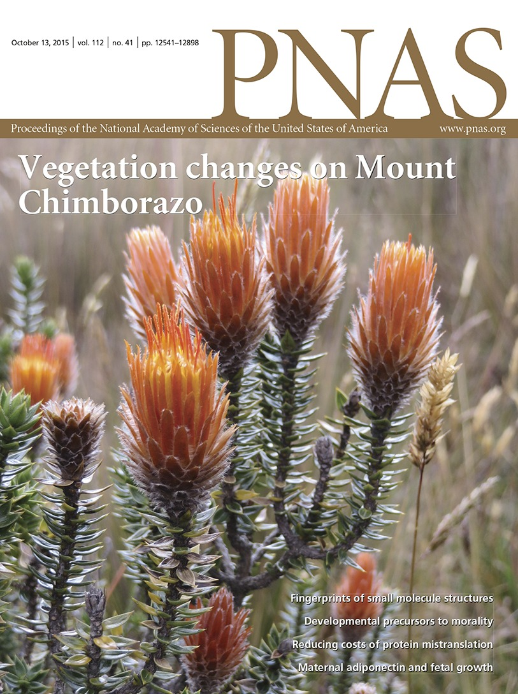
New scientists tackle old data
Naia Morueta-Holme and her team of scientists took the same path as Humboldt on Mount Chimborazo.
They surveyed plant samples and compared their Chimborazo map to the one Humboldt created 210 years ago.

Slide 9
What do you notice?
Species ID (on graph) | Species (Family) | Max Elevation (m) in 1802 Humboldt | Max Elevation (m) in 2012 Morueta-Holme | Elevation change (m)
A | Conyza cardaminifolia (Asteraceae) | 3100 | 4400 | +1300
B | Geranium humboldtii (Geraniaceae) | 4500 | 4300 | -200
C | Nertera granadensis (Rubiaceae) | 1600 | 4000 | +2400
D | Lasiocephalus ovatus (Asteraceae) | 4500 | 4700 | +300
Mountain feature | Elevation (m) in 1802 Humboldt | Elevation (m) in 2012 Morueta-Holme | Elevation change (m)
Upper vegetation limit | 4600 | 5200 | +600
Glacier limit | 4800 | 5300 | +500

Slide 10
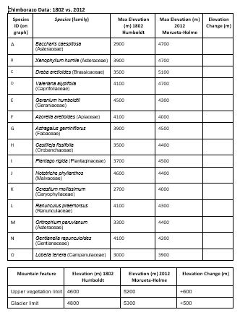
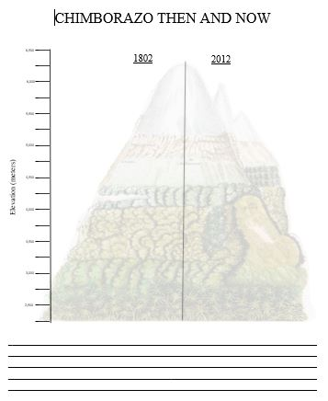
Graphing plants on Chimborazo
Directions:
First, calculate the elevation change on your own
Second, plot these 15 plants the same way we did together!
Third, plot the two mountain features as horizontal lines!

Slide 11
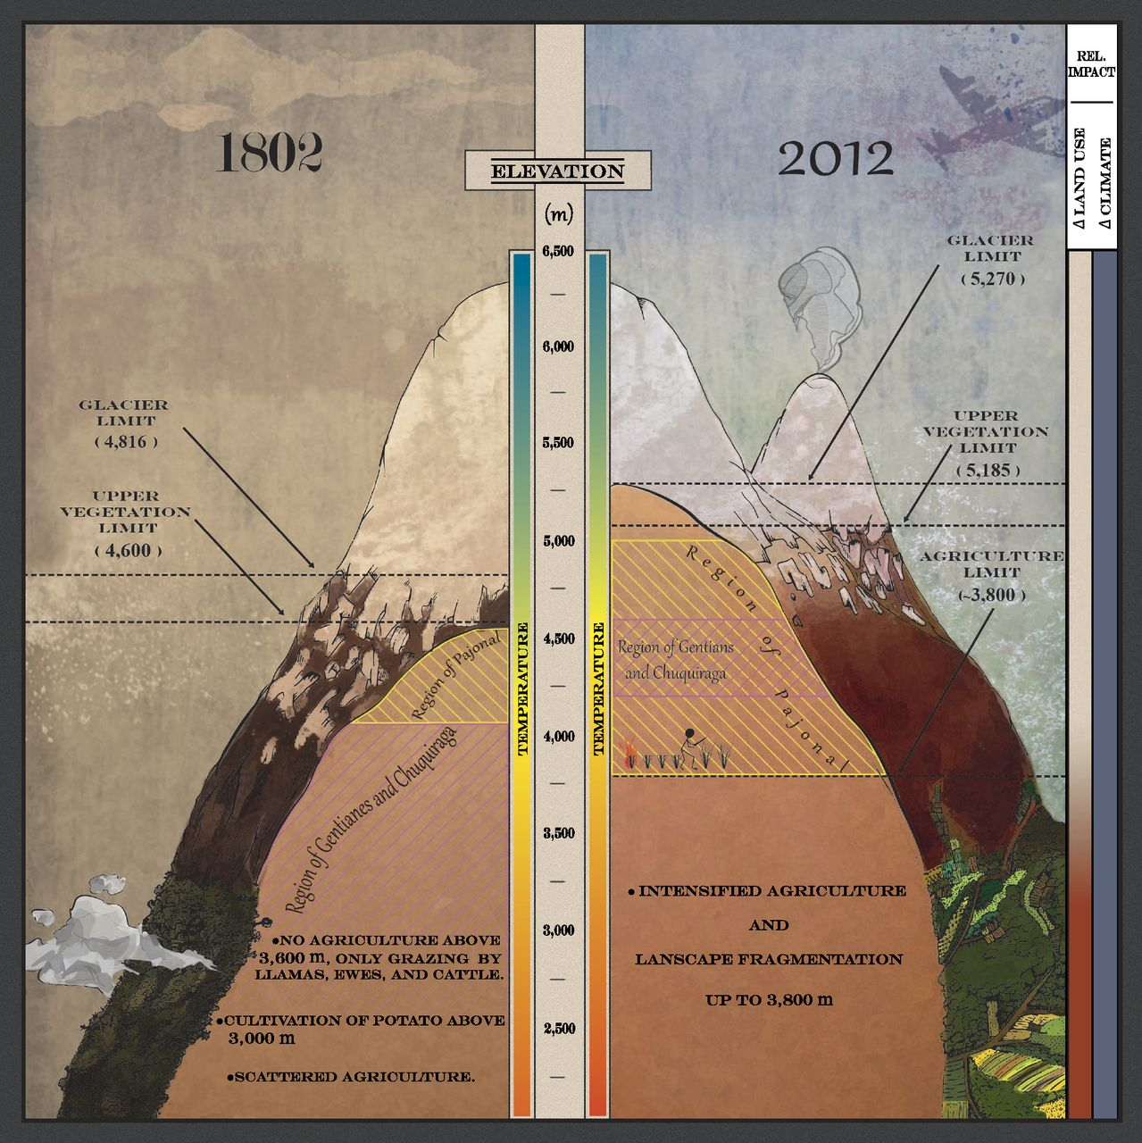
Chimborazo, then and now
Drawing of Humboldt’s findings in 1802 compared to Naia Morueta-Holme’s findings in 2012.
What do you notice?

Slide 12
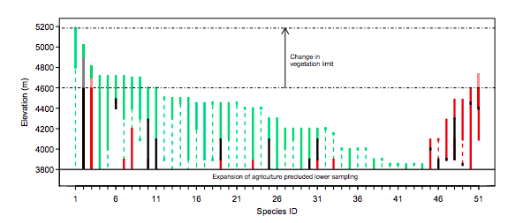
Evidence
Black = overlap between observed and historical range
Green = expansion upward
Red = decrease of either upper or lower range limit
Dashed vertical = plants present in Humboldt’s observations but not present in 2015
*No plants were recorded above 4,600 m in Humboldt’s texts

Slide 13
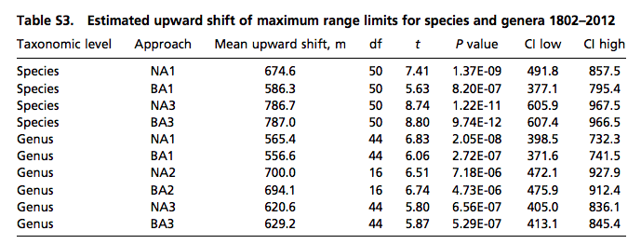
Evidence

Slide 14
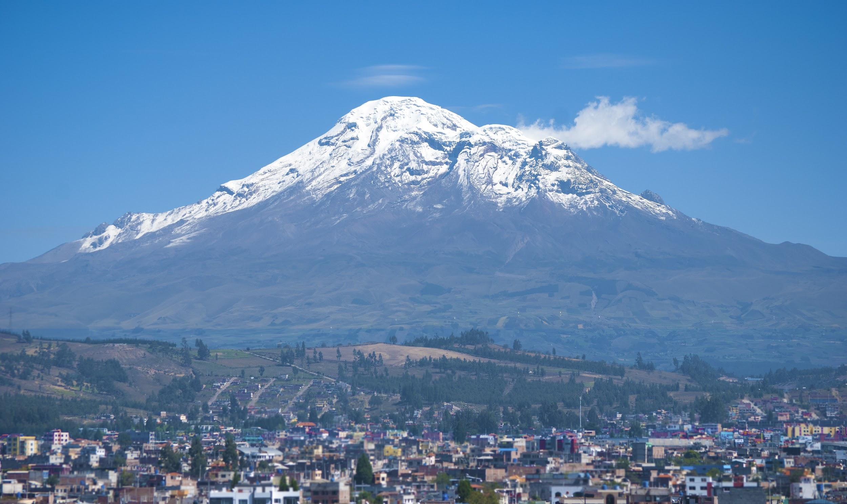
Discussion
What do you think is causing the upward shift of vegetation on Chimborazo?

