Slide 1
Design Notebook

Slide 2
Pre-work
Initial communication between teacher and engineer
Engineer fills in Storyboard with personal details to share with students
Teacher and engineer collaborate using Planning Meeting 1 as a guideline to identify and plan a design challenge.
Teacher and engineer collaborate using Planning Meeting 2 as a guideline identify constraints and resources to support design challenge.
**delete this slide prior to student use**

Slide 3
About our Team: (insert team name here)
Add a photo and interesting fact about each team member here.

Slide 4
Engineer Storyboard
Completed Storyboard linked here.

Slide 5
Engage & Explore:
Research the problem

Slide 6
Pre-work
Teacher and engineer collaborate using Planning Meeting 2 as a guideline identify constraints and resources to support design challenge.
**delete this slide prior to student use**

Slide 7
A Societal Problem
[Teachers insert links to age-appropriate readings and data that students can engage with to gain background knowledge of a human-centered issue]

Slide 8
Engineering Design Challenge Brief
Problem: [Students write a succinct summary of the problem].
Criteria | Constraints
Materials | Tools
Teacher, engineer, and students collaborate to list the criteria, constraints, materials, and tools for the challenge

Slide 9
Students: What does the research show?
List 5 ways that others have addressed this solution, and includes links to research.
1.
2.
3.
4.
5.

Slide 10
Student Application of Science Concepts
Directions: Use complete sentences to explain how science is used to better understand the problem and designing a solution.

Slide 11
Ask your Engineer Mentor...
Can you please provide feedback on our research and application of science ideas here?
[Engineer mentor inserts feedback here]

Slide 12
IMAGINE & EXPLAIN
Conceptualize ways to address the problem

Slide 13
Pre-work
It’s time for a virtual event!
Students meet their engineer virtually to get to know each other better and ask questions.
**delete this slide prior to student use**

Slide 14
Students: Brainstorm a list of possible solutions you could create to address the problem. Explain what the solution will do.
Design Ideas: | How does the solution address the problem?

Slide 15
Students: Upload your own drawing of a possible solution (add as many slides/ideas that you have!)
In the space below, write 2-3 sentences that describe how this solution could work.

Slide 16
Ask your Engineer Mentor…
Which solution(s) would be most feasible for me to design in class? Why?
Feel free to add additional slides for feedback if necessary.

Slide 17
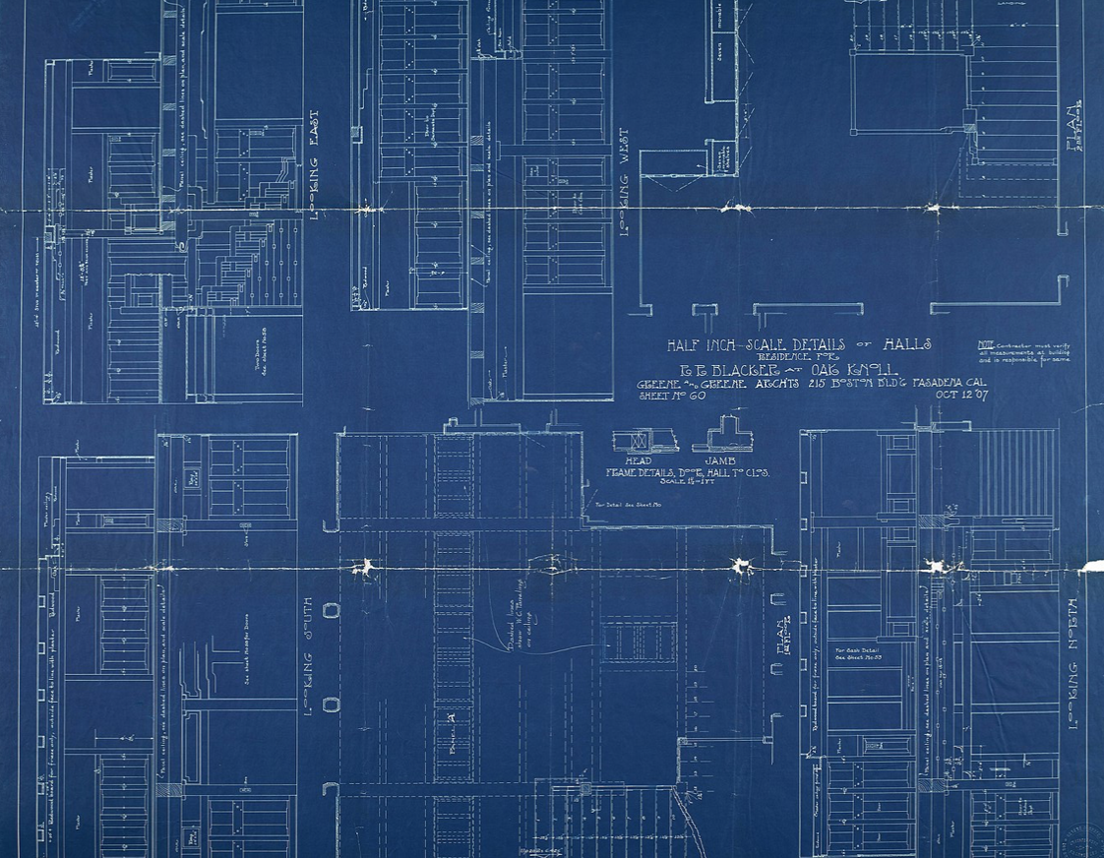
Elaborate & Build
Phase
Notes:
Image courtesy of the University of Southern California, accessed through Wikimedia Commons.

Slide 18
Pre-work
Gather appropriate materials for designs.
**delete this slide prior to student use**

Slide 19
Students: Prototype Your Design!
Upload a picture of your prototype here.

Slide 20
Students: Design Decisions
Describe in writing or through video how you decided to design your prototype.

Slide 21
TEST & EVALUATE

Slide 22
Pre-work
Remind students that this is just their first design and they will have an opportunity to make it even better the next time around.
**delete this slide prior to student use**

Slide 23
Students: Write a hypothesis about your design’s performance during testing below.
Notes:
increased in size (change in the independent variable), then it will fall at a
faster speed, (change seen in the dependent variable).
• Decide on a test for the model and try it out.
• Record the results of your tests.
Evaluate
• List the strengths of your design.
• List the weaknesses of your design.
• Discuss what changes, or compromises, in your design (if any) had to be
made due to constraints.
• Decide if your design solved the problem identified in Step 1.

Slide 24
Students: Upload a video of your group testing a solution

Slide 25
Students: Record the results of your test below.

Slide 26
Students: List 3 strengths and 3 weaknesses of your design
Strengths:
Weaknesses:

Slide 27
Ask your engineer mentor...
Could you please upload written or video feedback on our tested solution below?

Slide 28
Students: Redesign your solution based on your engineer’s feedback and upload a final image of your solution.

Slide 29
Students: Upload a video of your group retesting the solution

Slide 30
Students: Record the results of this second test

Slide 31
COMMUNICATE
Convey claims, evidence, and reasoning for why a solution is effective
Notes:
Cavallini Papers, accessed via Paper Source.

Slide 32
Pre-work
Create another live, virtual event with the engineer to allow students to test their final prototypes.
Brainstorm ideas about how students might extend the project’s impact beyond the classroom.
**delete this slide prior to student use**

Slide 33
Students: Share your work!
Replace this slide with a digital poster showing how you designed a solution to the community-based problem.

