Slide 1
The Trouble with Tavy

Slide 2
Lesson #1

Slide 3
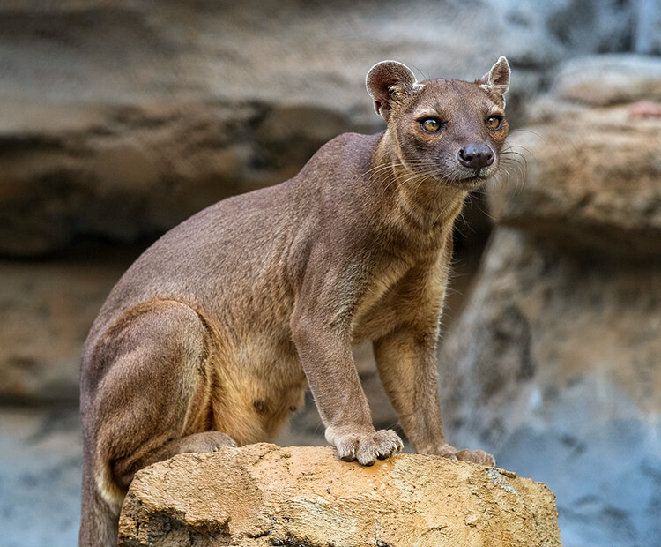
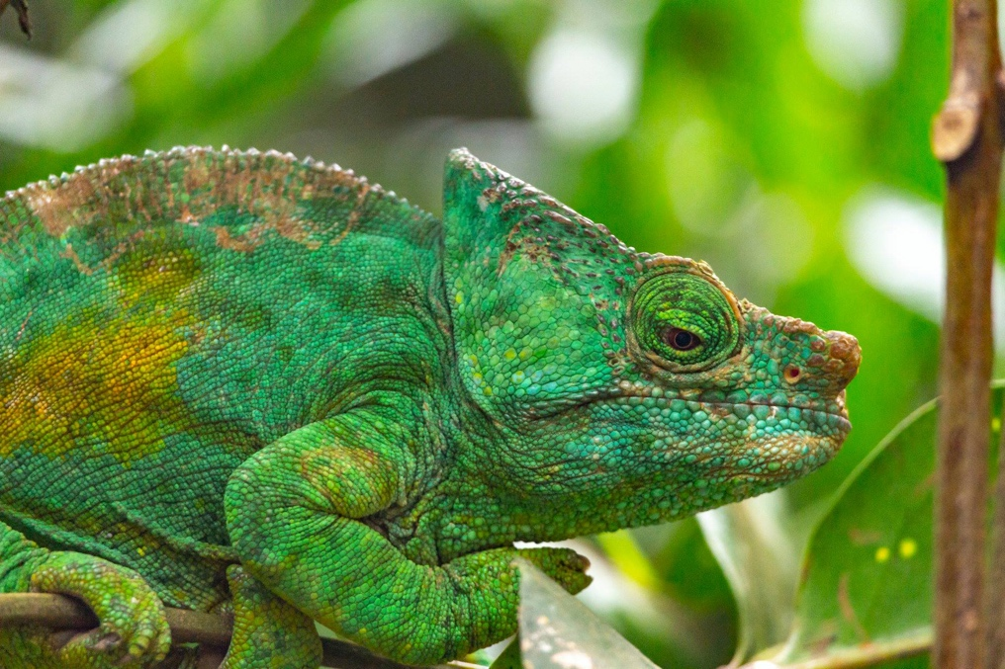
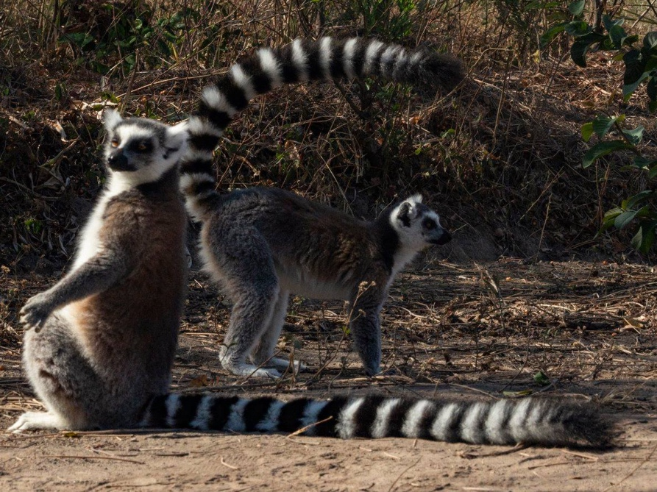
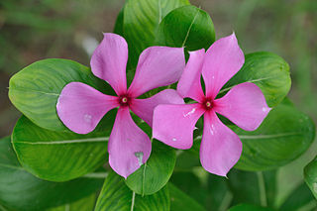
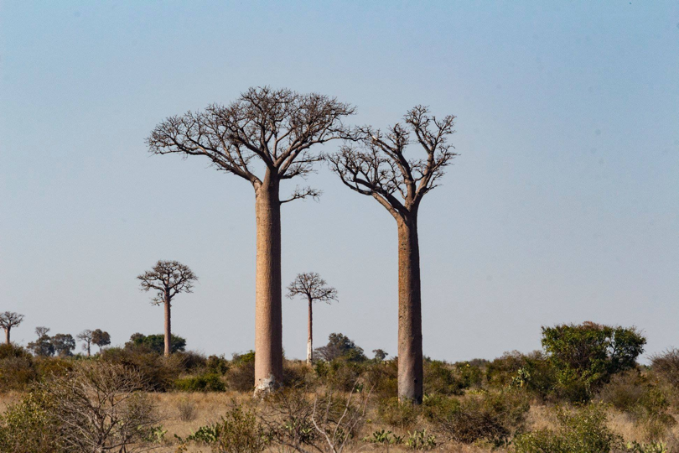
Do Now: What do all of these species have in common?
Fossa

Slide 4
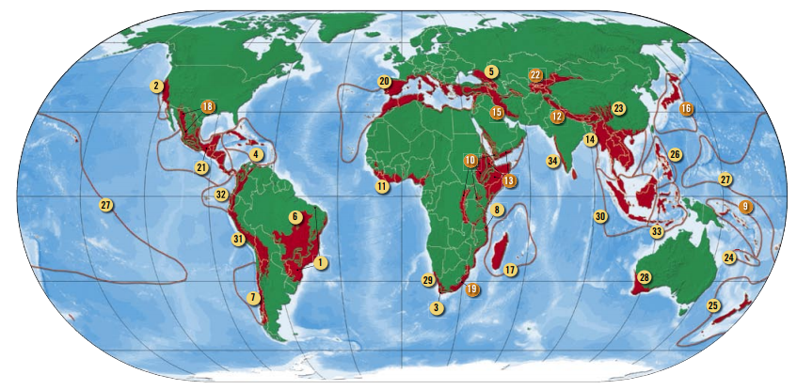
Identify on your maps the country of Madagascar

Slide 5
Think/Pair/Share: Based on what these species have in common, what words come to mind when you think about the term:
Endemic
Species
Endemic Species: A plant or animal native or only found in a certain country or area

Slide 6
Aim: How might species depend on endemic flora?
Do Now: Justify why a human might buy/own a Madagascar periwinkle species.
Décor
Medicinal purposes
Botanist/ scientists
I really just like flowers
Think/Pair/Share
How might an animal, such as a herbivore benefit from the Madagascar periwinkle?

Slide 7
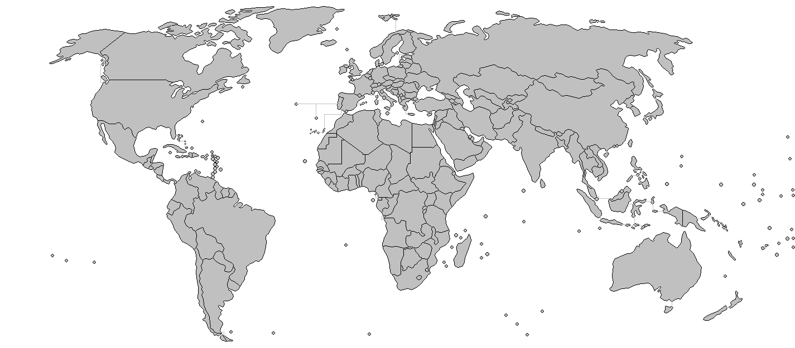
Medical uses for Periwinkle
Hawaii: Stop bleeding
China: Cough remedy
Caribbean: Eye infection
Philippines: Used to treat diabetes during WWII
Central and South America: Used for inflammation and sore throat
India: wasp sting treatment

Slide 8
Understanding pH (potential hydrogen)
pH represents how acidic or alkaline a material is.
pH is measured on a scale of 0 to 14
How to increase soil pH: Add the base calcium carbonate (CaCO₃) - A chemical compound which is common in rocks
How to decrease soil pH: Add organic materials such as pine leaves, composted manure. Their decomposition creates acidic byproducts.
Notes:
https://www.wikihow.com/Adjust-Soil-pH

Slide 9
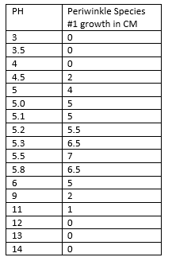
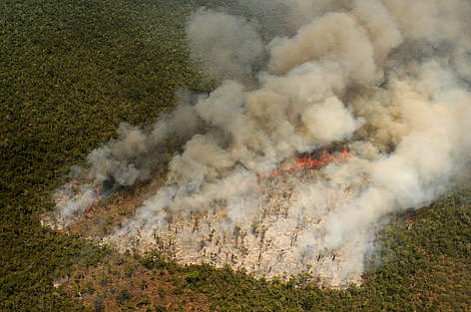
Scenario: Tavy is use by various ethnic groups to create usable farmland in rainforests to grow crops however, once the land is used up, degraded soil leads to an increase in pH.
We will plot the data as a graph to determine how soil pH affects periwinkle growth.

Slide 10
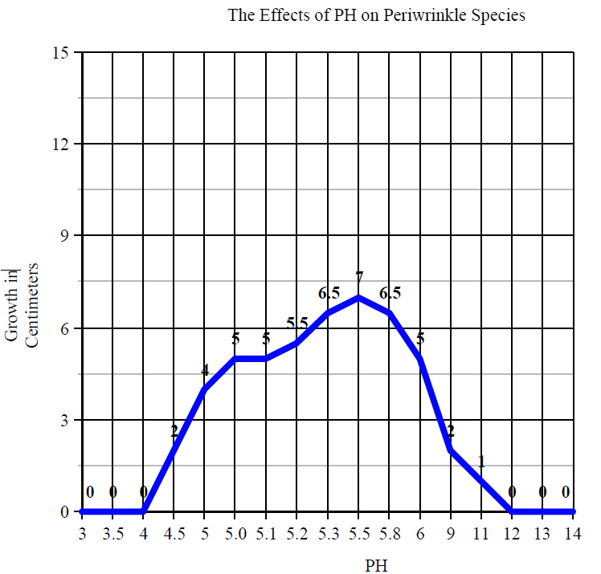
What is the ideal soil pH for growing periwinkle?
What happens to periwinkle if the soil becomes too acidic or too basic?

Slide 11
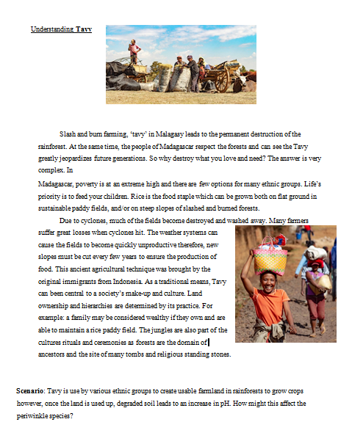
Student reading on TAVY

Slide 12
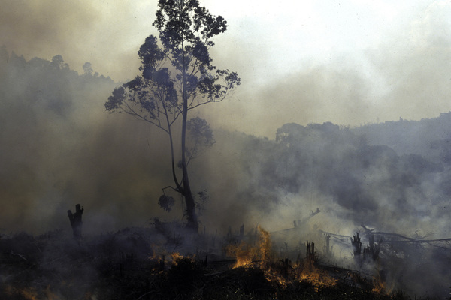
Video on Tavy
https://www.youtube.com/watch?v=dGSaQE3yp2o

Slide 13
Lesson #2

Slide 14
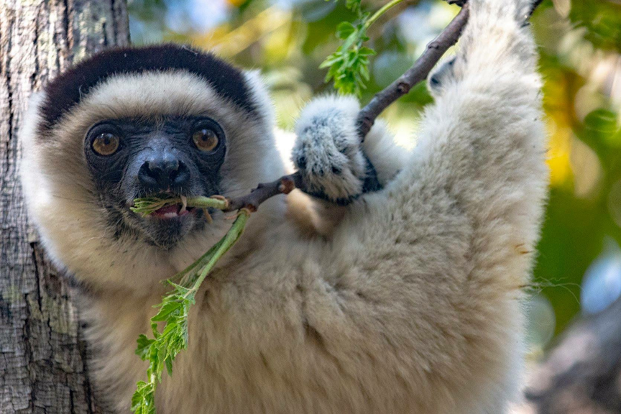
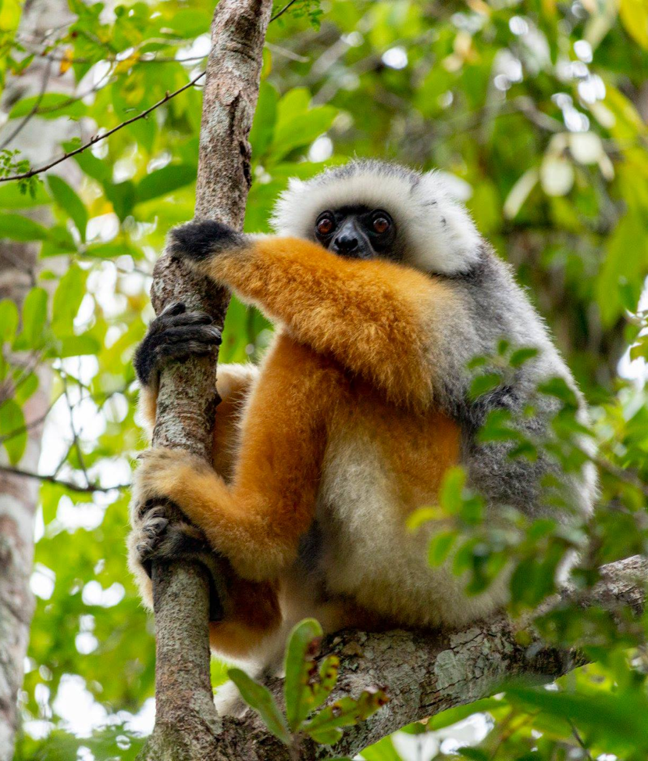
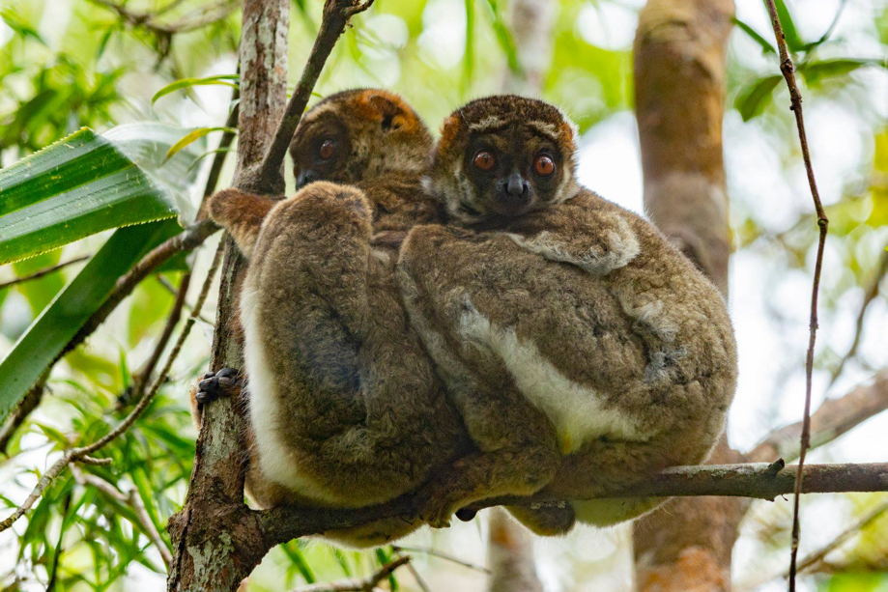
Lemurs come from the scientific name “Prosimians” meaning “before Monkeys”.
Lemurs evolved between 40 - 50 million years ago
Focus today will be on four Lemur Species
1. Ring-Tailed Lemur
2. Silky Sifaka Lemur
3. Bamboo Lemurs
4. Aye-Aye

Slide 15
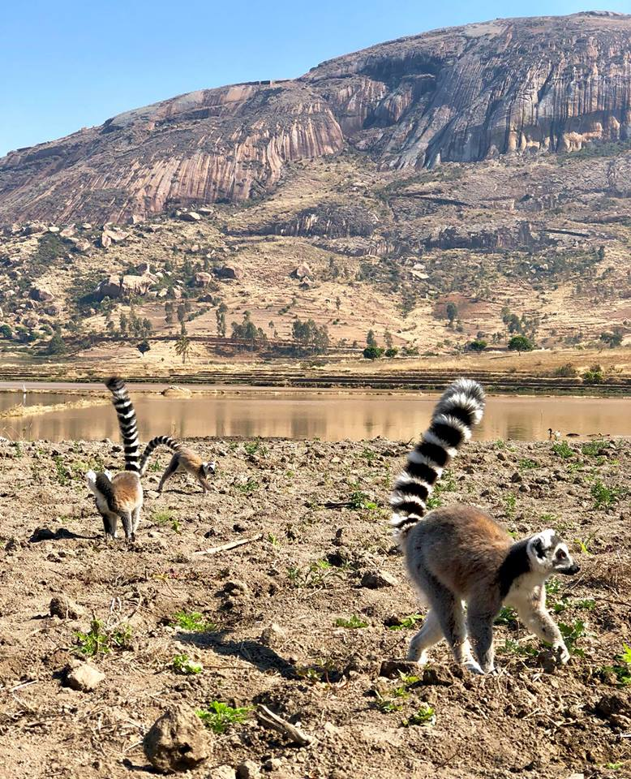
Jigsaw Activity
Each person in a group chooses one lemur species
Read independently (2 minutes)
Annotate the text underlining information which helped you complete the boxes at the bottom of your worksheet. (1 minute)
Share out with your group (3 Minutes)
Complete evaluation questions based on your new understanding of all lemurs.

Slide 16
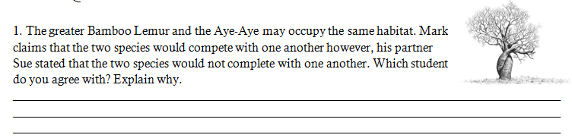
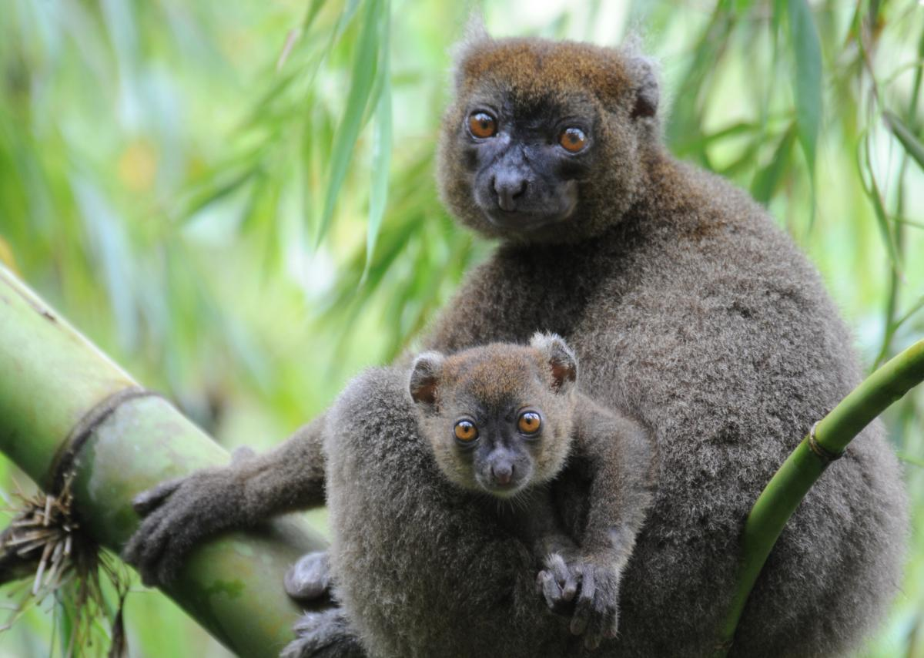
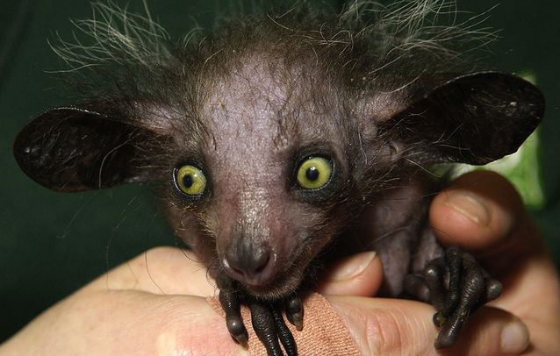

Slide 17
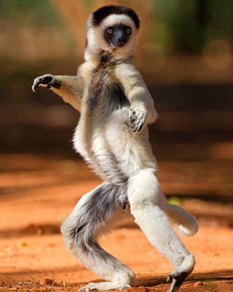
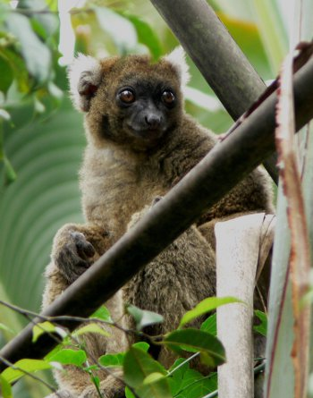
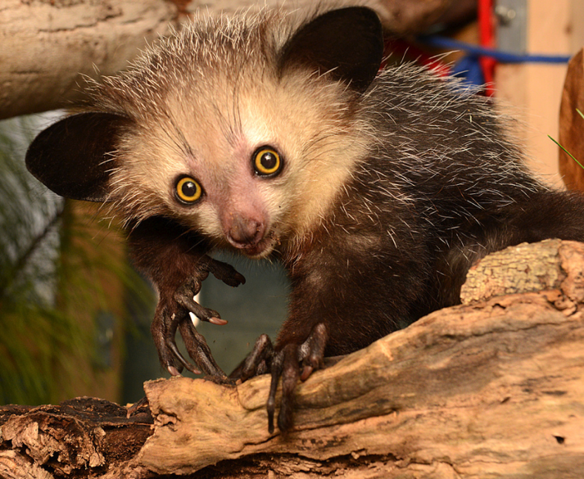
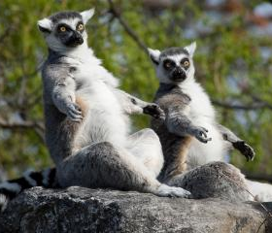
Real-world Scenario
1. Agricultural farming has expanded due to an increase in human population. Predict which species of lemur would be able to survive and explain why you believe this species will be most successful when compared to the other species of lemur.

Slide 18
Individual Stakeholder Cards

Slide 19
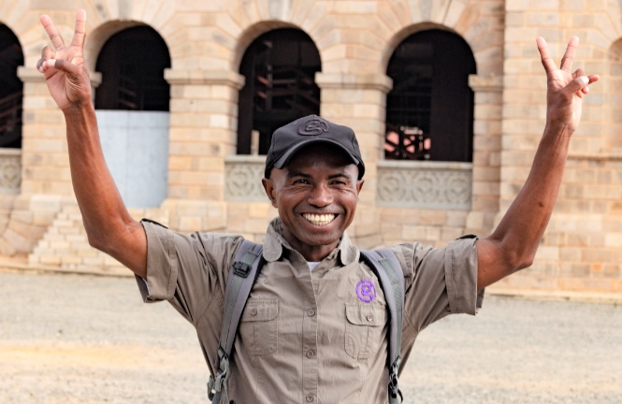
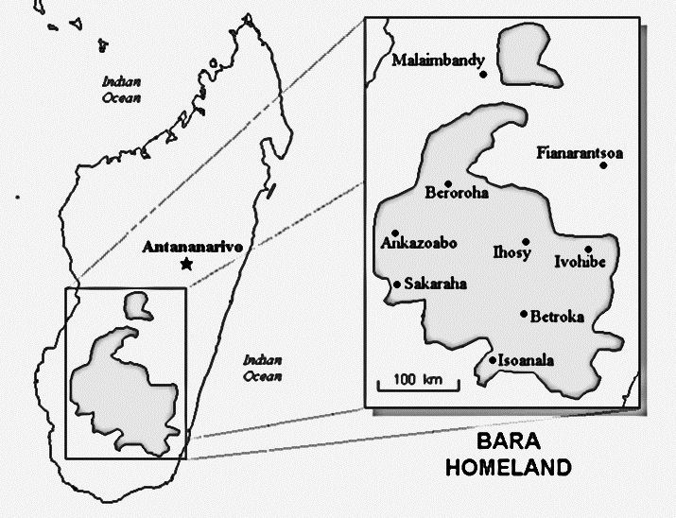
Jean Coco Randrianatoavina
Ethnic Group: Bara
Location: South-central Madagascar
Population: 876,000
Job: Tourism
Explanation of Job Title: Jean Coco works for Gadventures as a lead guide. Working with Gadventures allows Coco to meet other people from a variety of cultures around the world. Coco guides his visitors throughout the country of Madagascar and shares his knowledge on local life as a Malagasy in Madagascar.
“The tours are linked with a sustainable travel experience so when you travel with me, you support projects that help protect the planet for generations to come.” - Coco
Places visited with Jean Coco include:
Scientific Research center
Lemur spotting in collaboration with other guides.
Homestay with the local ethnic group – Learn about how to construct rice fields and grow food for locals
Visit to the local markets
Hiking in four National Parks to spot endemic species and learn about medical plants.
Notes:
Map: https://joshuaproject.net/assets/media/profiles/maps/m10672_ma.pdf

Slide 20
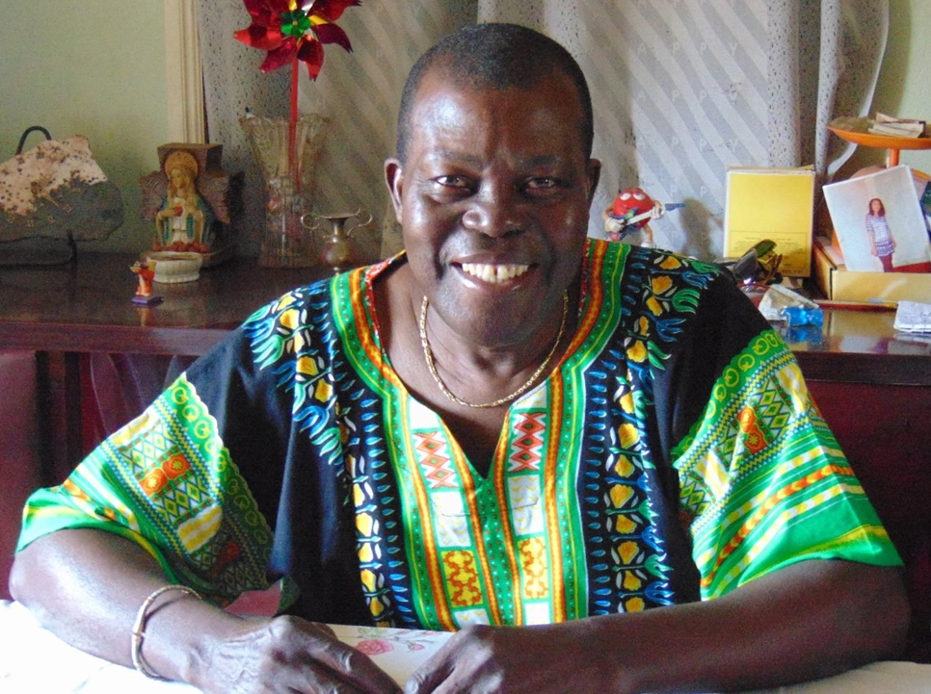
Dr. Nat Quansah
2000 Goldman Prize Recipient Islands and Island Nations
Ethnic Group: Merina ("People of the highlands")
Location: City of Antananarivo / Central highlands of Madagascar.
Population: 1,300,000
Job: Ethnobotanist
Explanation of Job Title: Concerned about deforestation and the loss of many cultural traditions, Nat Quansah, opened a clinic in the northwestern village of Ambodisakoana in 1994. There he developed the Integrated Health Care and Conservation Program in which the cultural tradition of using natural substances for medicinal purposes is being reintroduced. With the assistance of a local traditional healer, he taught the community to treat coughs, diarrhea, fever and wounds using local plants.
Background information on research: Madagascar is the fourth largest and one of the most isolated of the world’s great islands. This isolation gave rise to a tremendous array of unique plants and animals. More than 80 percent of Madagascar’s species are endemic and represent about five percent of the world’s total plant and animal species.
Notes:
Photo: Nats Facebook
Information: https://www.goldmanprize.org/recipient/nat-quansah/

Slide 21
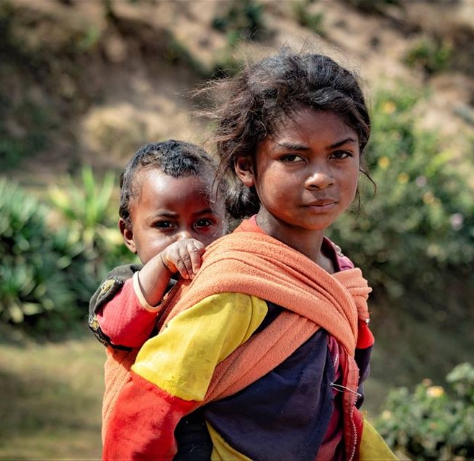
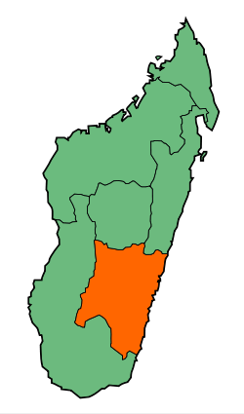
Miora Rakotomalala
Ethnic Group: Betsileo
Location: Southern portion of the central highlands
Population: 1.5 million
Job: Farmer
Explanation of Farming Practices: In order to feed their families farming is one of the most popular careers. The Betsileo ethnic group construct rice paddies on narrow terraces ascending the sides of steep valleys. The irrigation systems use all available water, which flows through narrow canals for long distances. The rice is picked and taken to the markets to be sold to the other villagers.
Background information: Madagascar is the largest producer of natural vanilla and the net-importer of rice since 1980. Slash and burn methods are used to create rice patties. Slash-and-burn agriculture is a method of cultivation in which existing vegetation is cut down and burned off before new seeds are sown, typically used as a method for clearing forest land for farming.
Notes:
https://ipfs.io/ipfs/QmXoypizjW3WknFiJnKLwHCnL72vedxjQkDDP1mXWo6uco/wiki/Agriculture_in_Madagascar.html
http://juliehphotos.com

Slide 22
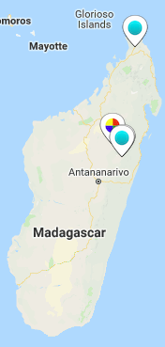
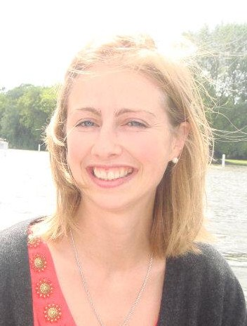
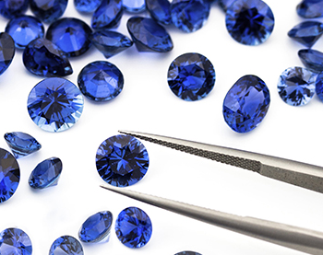
Rosey Perkins
Owner of: www.Roseyperkins.com
Location: United Kingdom, Europe
Job: Gemologist
Explanation of Gemologist: Sapphire is a gem that is found in Madagascar. Deposits can be found underground in the gravels of ancient river beds. Some are unusually large and have a blue color.
Background Information: The discovery of precious stones has led to rapid development in a number of parts of the country. Sapphire can sell anywhere between hundreds to thousands of dollars. Usually the local people will clear the land and begin the digging process on the hunt for Sapphire.
“I estimated there were 1,000 miners in the Tananarive Carrier area in search for Sapphires” – Rosey Perkins
<iframe src="https://player.vimeo.com/video/192108090" width="640" height="360" frameborder="0" allowfullscreen></iframe>

Slide 23
Data Sources

Slide 24
Document #1: Resource Map on Vegetation in Madagascar
(SEE PDF)

Slide 25
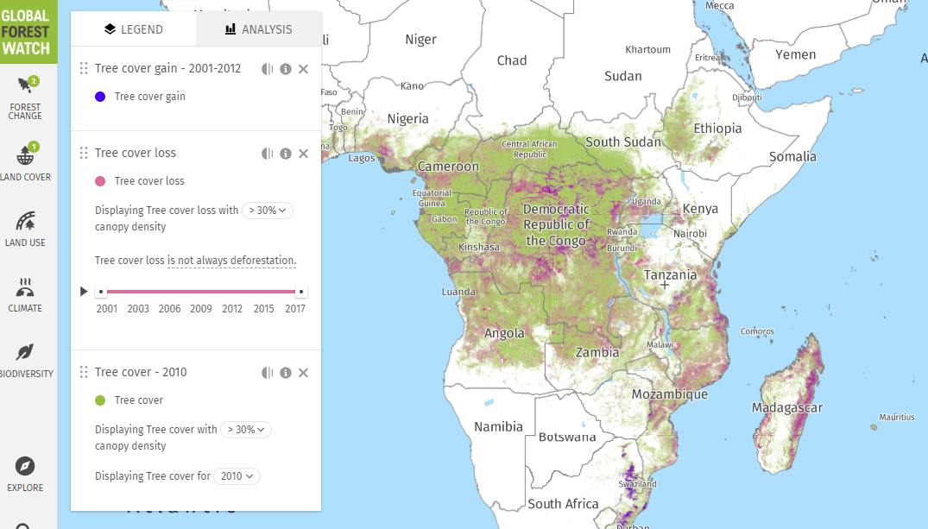
Document #2: Interactive Map Deforestation
(Use the online simulation)

Slide 26
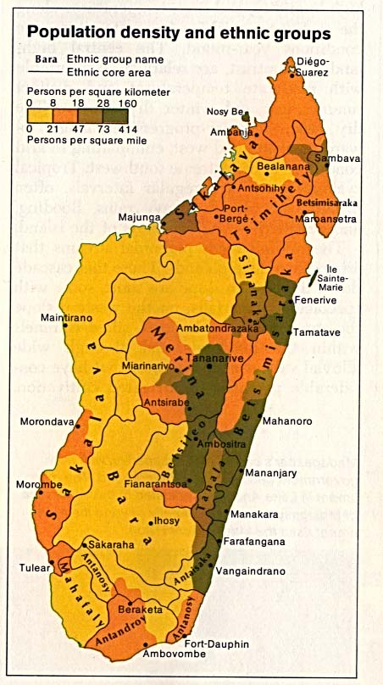
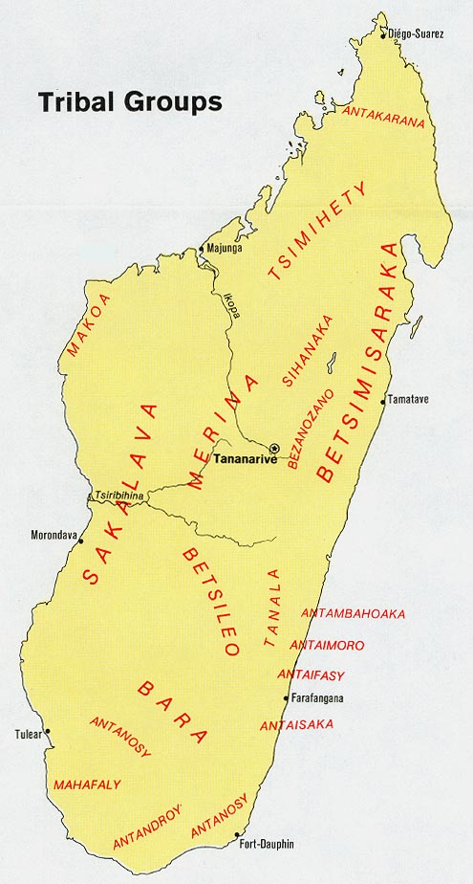
Document #3: Ethnic Group data

Slide 27
Lemur Distribution Document #4
(See Lemur Jigsaw Activity)

